Slide 1

TOPSELLER
QUICK REFERENCE GUIDE
Canada | March 2023
V1 2023

Slide 2
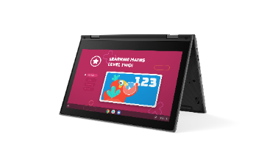
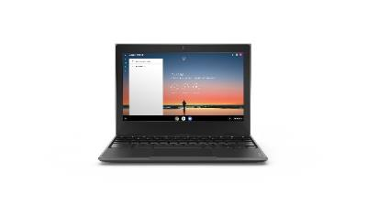
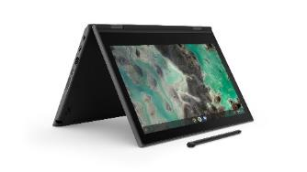
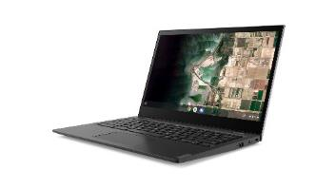
LENOVO TOPSELLERS - EDUCATION
[ 1 OF 1 ]
100e Chromebook G2 – MTK | $389
 | 82Q30003US
 | MediaTek MT8183
 | 4GB (soldered)
 | 32GB eMMC (soldered)
 | 11.6” HD TN Anti-glare
 | Camera, 2x2 AC WLAN, BT
 | 45Whr Battery
 | Chrome OS
 | 1 Year Mail-in
100e Chromebook G3 – AMD | $429
 | 82J70005US
 | 82J70005CF
 | AMD 3015Ce
 | 4GB (soldered)
 | 32GB eMMC (soldered)
 | 11.6” HD TN Anti-glare
 | Camera, 2x2 AC WLAN, BT
 | 47Whr Battery
 | Chrome OS
 | 1 Year Mail-in
100e Chromebook G3 – Intel | $459
 | 82UY0000US
 | Intel Celeron N4500
 | 4GB (soldered)
 | 32GB eMMC (soldered)
 | 11.6” HD TN Anti-glare
 | Camera, 2x2 AC WLAN, BT
 | 42Whr Battery
 | Chrome OS
 | 1 Year Mail-in
500e Chromebook G3 | $639
 | 82JB0001US
 | 82JB0001CF
 | Intel Celeron N5100
 | 4GB (soldered)
 | 32GB eMMC (soldered)
 | 11.6" HD IPS Touch
 | World Facing Camera, 2x2 AC WLAN, BT, Pen
 | 42Whr Battery
 | Chrome OS
 | 1 Year Mail-in
14e Chromebook G2 – AMD | $519
 | 82M1000GUS
 | 82M1000GCF
 | AMD 3015Ce
 | 4GB (soldered)
 | 32GB eMMC (soldered)
 | 14" FHD IPS Anti-glare
 | Camera, 2x2 AC WLAN, BT
 | 57Whr Battery
 | Chrome OS
 | 1 Year Mail-in
300e Chromebook
300e Chromebook G3 | $539 | $549
 | 82J9000EUS | 82J9000NUS
 | 82J9000ECF
 | AMD 3015Ce | Intel Celeron N4020
 | 4GB (soldered) | 4GB (soldered)
 | 32GB eMMC (soldered) | 32GB eMMC (soldered)
 | 11.6” HD IPS Touch | 11.6” HD IPS Touch
 | Camera, 2x2 AC WLAN, BT | World Facing Camera, 2x2 AC WLAN, BT
 | 47Whr Battery | 47Whr Battery
 | Chrome OS | Chrome OS
 | 1 Year Mail-in | 1 Year Mail-in
500e Chromebook
14e Chromebook
100e Chromebook

Slide 3
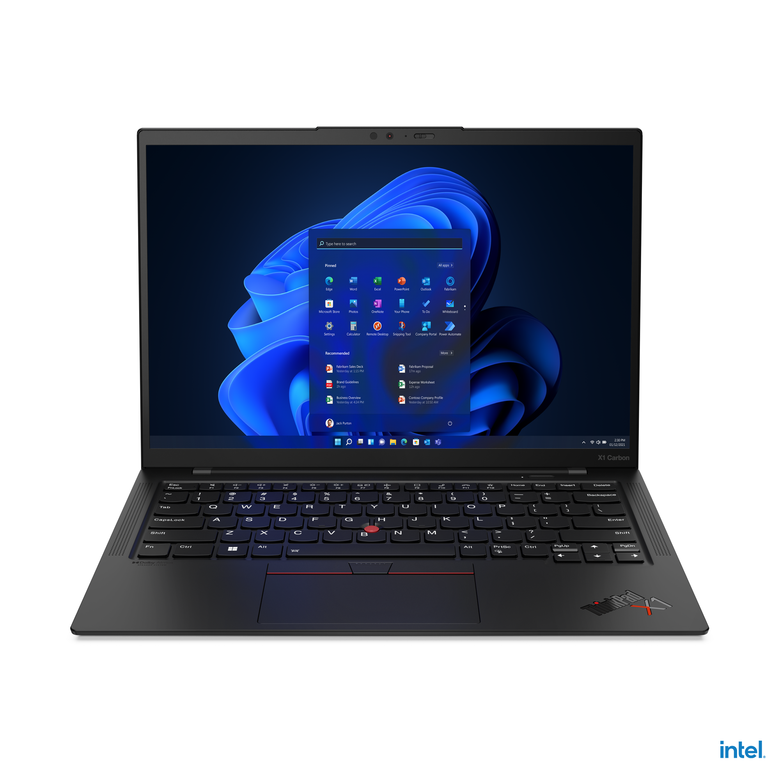
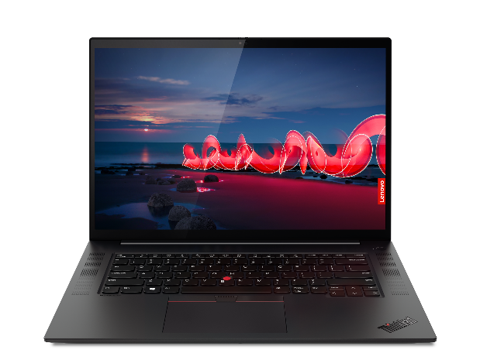
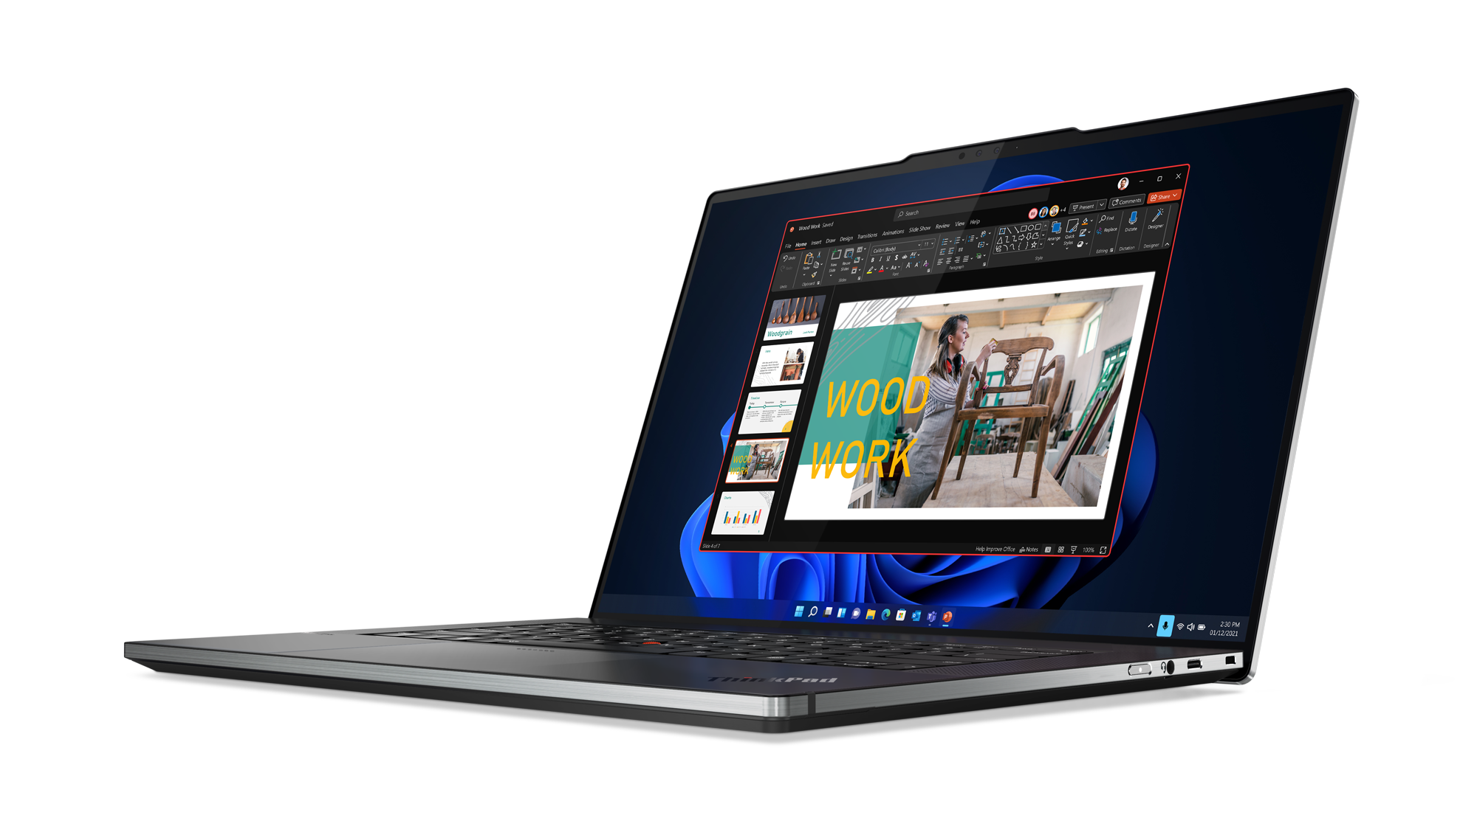
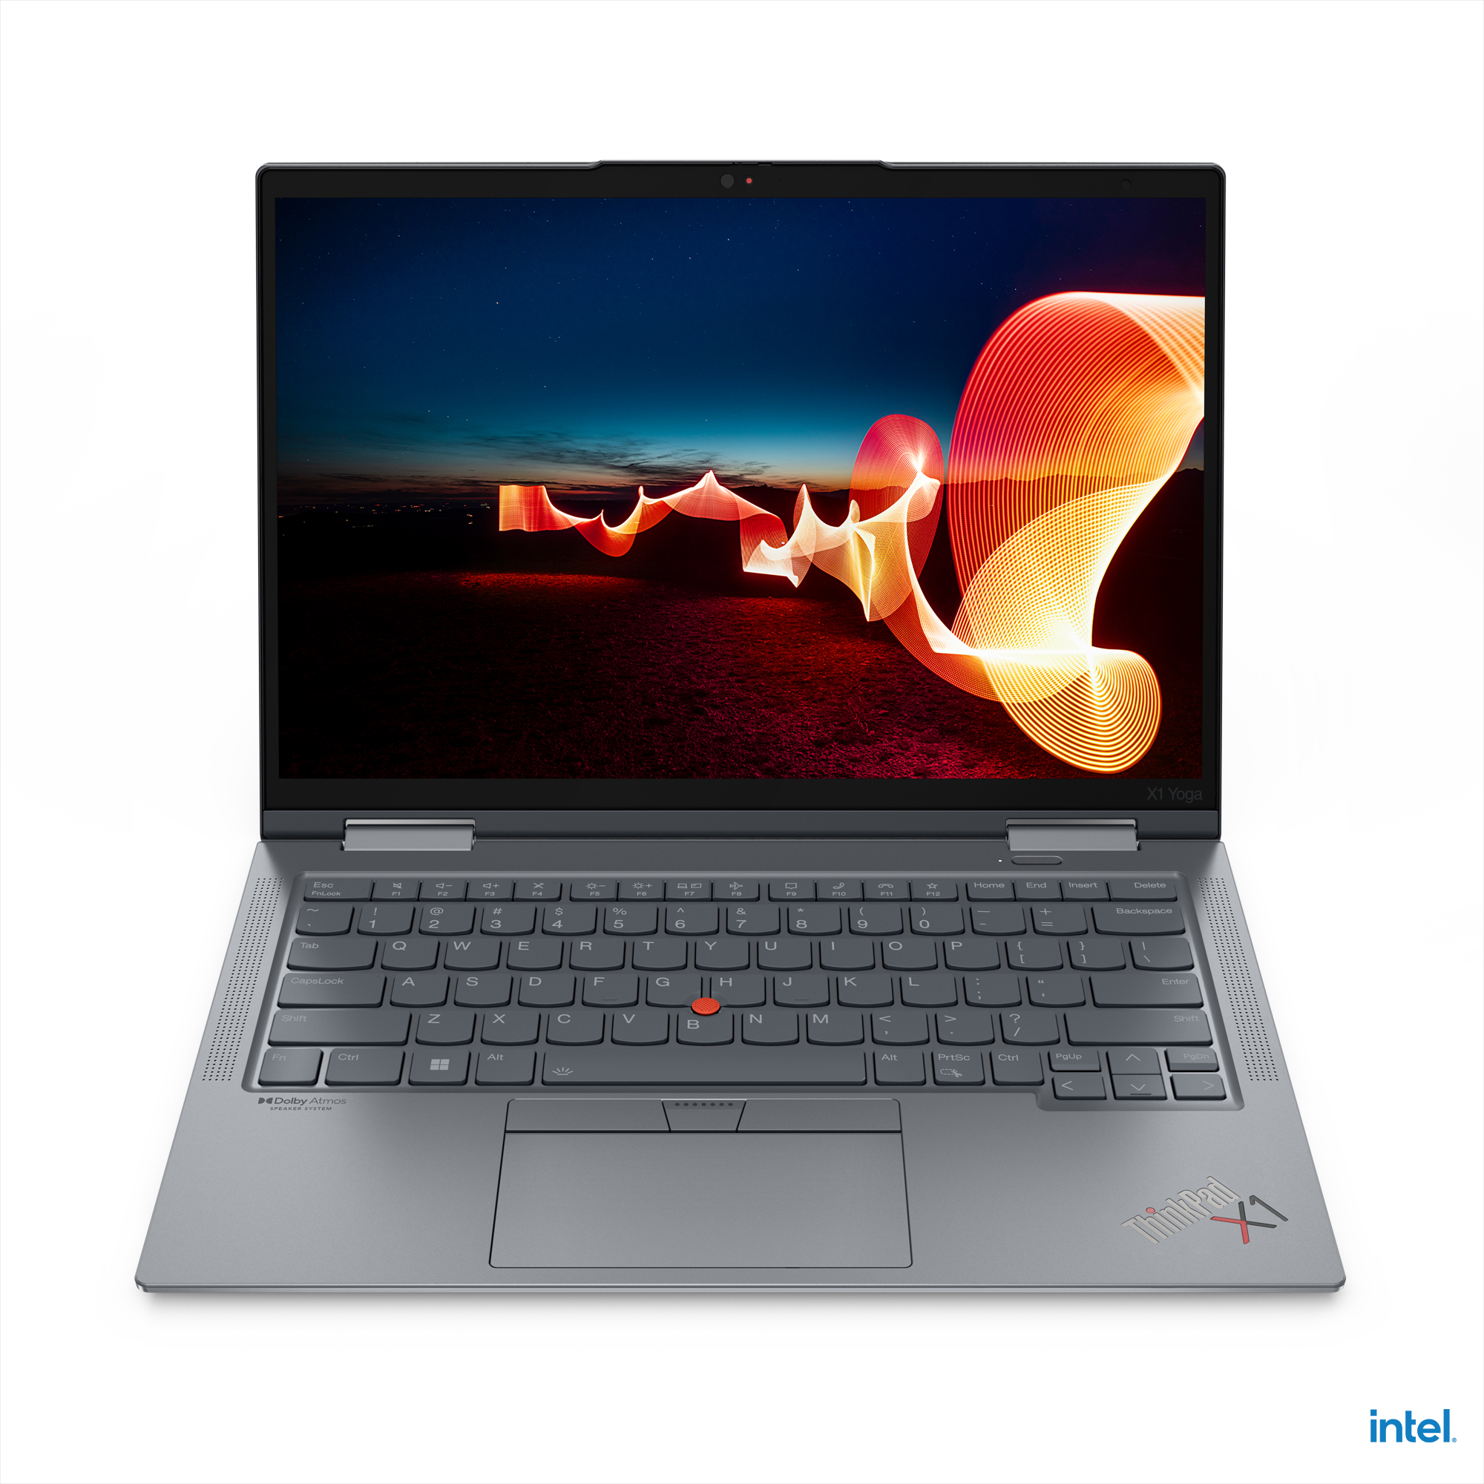
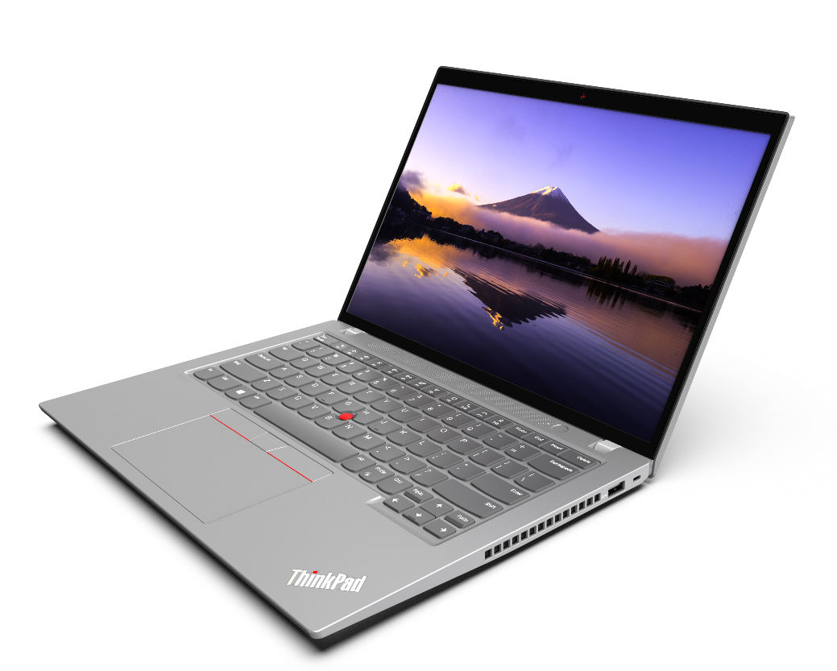
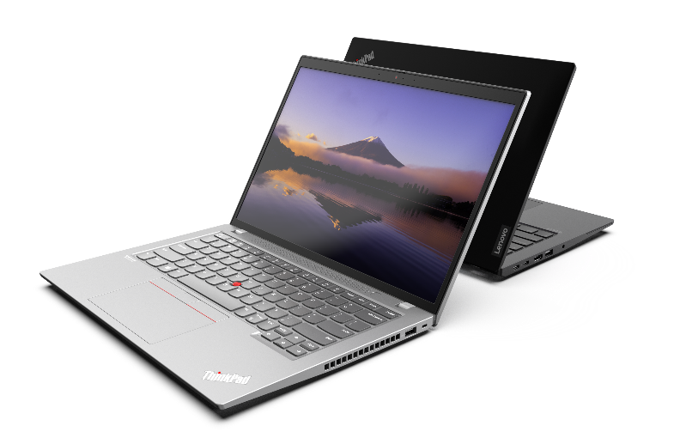
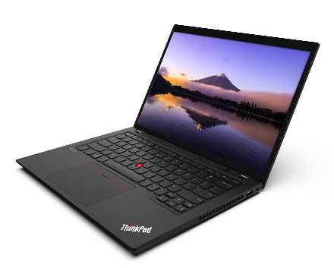
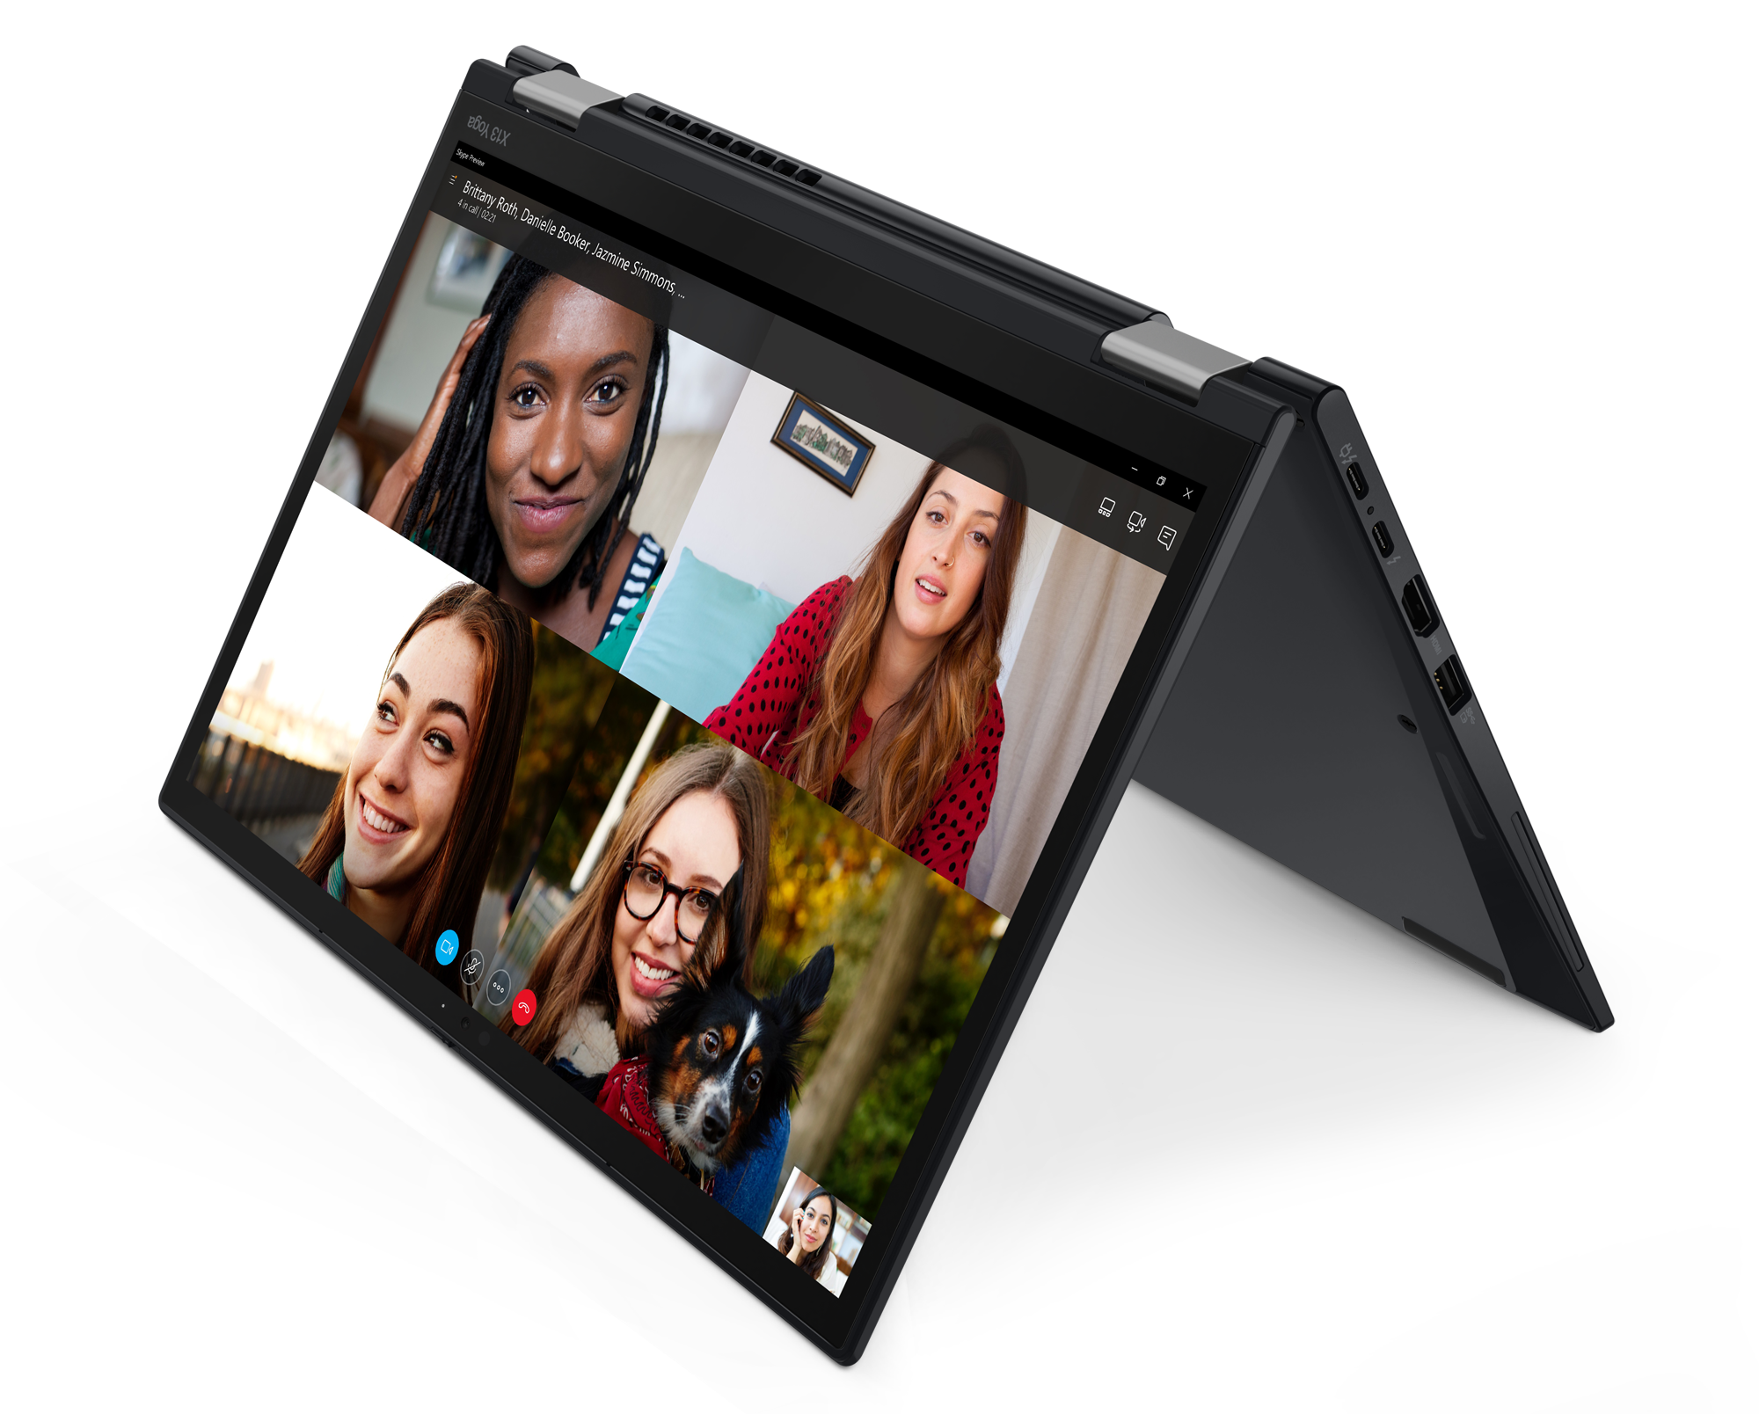
THINKPAD PREMIUM TOPSELLER NOTEBOOKS
[ 1 OF 4 ]
X1 Yoga 7th Gen
Z16 G1
X1 Carbon 10th Gen
X1 Extreme 5th Gen
X13 Yoga G3
T14 G3 (Intel/AMD)
T14s G3 (Intel/AMD)
T16 G1 (Intel/AMD)

Slide 4
THINKPAD PREMIUM TOPSELLER NOTEBOOKS
X & Z Series
[ 2 OF 4 ]
X1 Carbon 10th Gen | $2539 | $3059 | $3259
 | 21CB000AUS | 21CB000CUS | 21CB009KUS
 | 21CB000ACA | 21CB000CCA | 21CB009KCA
 | Core i5-1240P | Core i7-1260P | Core i7-1270P
 | 16GB DIMM | 16GB DIMM | 16GB DIMM
 | 256GB SSD NVMe | 512GB SSD NVMe | 512GB SSD NVMe
 | 14” WUXGA IPS Anti-glare | 14” WUXGA IPS Anti-glare Touch | 14” WUXGA IPS Anti-glare Touch
 | Camera w/Shutter, FPR, 2x2 AX WLAN, BT, Backlit Keyboard, Carbon Fiber | Camera w/Shutter, FPR, 2x2 AX WLAN, BT, Backlit Keyboard, Carbon Fiber | Camera w/Shutter, FPR, 2x2 AX WLAN, BT, Backlit Keyboard, Carbon Fiber
 | Integrated 57Whr Battery | Integrated 57Whr Battery | Integrated 57Whr Battery
 | Win11 Pro DG Win10 | Win11 Pro DG Win10 | Win11 Pro DG Win10
 | 3 Year Depot | 3 Year Depot | 3 Year Depot
X1 Yoga 7th Gen | $2769 | $3219
 | 21CD0045US | 21CD000GUS
 | 21CD0045CA | 21CD000GCA
 | Core i5-1235U | Core i7-1260P
 | 16GB DIMM | 16GB DIMM
 | 256GB SSD NVMe | 512GB SSD NVMe
 | 14” WUXGA IPS Anti-glare Touch | 14” WUXGA IPS Anti-glare Touch
 | Camera w/Shutter, FPR, 2x2 AX WLAN, BT, Backlit Keyboard, Carbon Fiber | Camera w/Shutter, FPR, 2x2 AX WLAN, BT, Backlit Keyboard, Carbon Fiber
 | Integrated 57Whr Battery | Integrated 57Whr Battery
 | Win11 Pro DG Win10 | Win11 Pro DG Win10
 | 3 Year Depot | 3 Year Depot
X13 Yoga Gen 3 | $2199 | $2389
 | 21AW002MUS | 21AW002NUS
 | 21AW002MCA | 21AW002NCA
 | Core i5-1235U | Core i7-1255U
 | 16GB DIMM | 16GB DIMM
 | 256GB SSD NVMe | 256GB SSD NVMe
 | 13.3” WUXGA IPS Anti-glare Touch | 13.3” WUXGA IPS Anti-glare Touch
 | Camera w/Shutter, FPR, 2x2 AX WLAN, BT, Backlit Keyboard | Camera w/Shutter, FPR, 2x2 AX WLAN, BT, Backlit Keyboard
 | Integrated 52.8Whr Battery | Integrated 52.8Whr Battery
 | Win11 Pro DG Win10 | Win11 Pro DG Win10
 | 3 Year Depot | 3 Year Depot
X1 Extreme Gen 5 | $3249
 | 21DE0049US
 | 21DE0049CA
 | Core i5-1235U
 | 16GB DIMM
 | 256GB SSD NVMe
 | 13.3” WUXGA IPS Anti-glare Touch
 | Camera w/Shutter, FPR, 2x2 AX WLAN, BT, Backlit Keyboard
 | Integrated 52.8Whr Battery
 | Win11 Pro DG Win10
 | 3 Year Depot
Z16 Gen 1 | $2559 | $2729
 | 21D4001UUS | 21D4001VUS
 | 21D4001UCA | 21D4001VCA
 | Ryzen 5 Pro 6650H | Ryzen 7 Pro 6850H
 | 16GB DIMM | 16GB DIMM
 | 256GB SSD NVMe | 512GB SSD NVMe
 | 16” WUXGA IPS Anti-glare | 16” WUXGA IPS Anti-glare
 | Camera w/Shutter, FPR, 2x2 AX WLAN, BT, Backlit Keyboard, Aluminum | Camera w/Shutter, FPR, 2x2 AX WLAN, BT, Backlit Keyboard, Aluminum
 | Integrated 72Whr Battery | Integrated 72Whr Battery
 | Win11 Pro DG Win10 | Win11 Pro DG Win10
 | 3 Year Depot | 3 Year Depot
X1 Carbon 10th Gen
Z16 Gen 1

Slide 5


THINKPAD PREMIUM TOPSELLER NOTEBOOKS
T Series – Intel
[ 3 OF 4 ]
T14 G3 – Intel | $2269 Rebate $100 | $2419 Rebate $75 | $2489 Rebate $75 | $2569 Rebate $50 | $2619 | $3109 Rebate $100
 | 21AH00BQUS | 21AH00BPUS | 21AH00BRUS | 21AH00BLUS | 21AH00BSUS | 21AH00BNUS
 | 21AH00BQCA | 21AH00BPCA | 21AH00BRCA | 21AH00BLCA | 21AH00BSCA | 21AH00BNCA
 | Core i5-1235U | Core i5-1235U | Core i5-1235U | Core i7-1245U | Core i7-1260P | Core i7-1270P
 | 8GB DIMM | 8GB DIMM | 8GB DIMM | 8GB DIMM | 8GB DIMM | 8GB DIMM
 | 256GB SSD NVMe | 512GB SSD NVMe | 512GB SSD NVMe | 512GB SSD NVMe | 512GB SSD NVMe | 512GB SSD NVMe
 | 14” WUXGA IPS Anti-glare | 14” WUXGA IPS Anti-glare | 14” WUXGA IPS Anti-glare Touch | 14” WUXGA IPS Anti-glare | 14” WUXGA IPS Anti-glare | 14” 2.2K IPS Anti-glare
 | Camera w/Shutter, FPR, 2x2 AX WLAN, BT, Backlit Keyboard | Camera w/Shutter, FPR, 2x2 AX WLAN, BT, Backlit Keyboard | Camera w/Shutter, FPR, 2x2 AX WLAN, BT, Backlit Keyboard | Camera w/Shutter, FPR, 2x2 AX WLAN, BT, Backlit Keyboard | IR Camera w/Shutter, FPR, 2x2 AX WLAN, BT, Backlit Keyboard | IR Camera w/Shutter, FPR, 2x2 AX WLAN, BT, Backlit Keyboard
 | Integrated 52.5Whr Battery | Integrated 52.5Whr Battery | Integrated 52.5Whr Battery | Integrated 52.5Whr Battery | Integrated 52.5Whr Battery | Integrated 52.5Whr Battery
 | Win11 Pro DG Win10 | Win11 Pro DG Win10 | Win11 Pro | Win11 Pro DG Win10 | Win11 Pro DG Win10 | Win11 Pro DG Win10
 | 3 Year Depot | 3 Year Depot | 3 Year Depot | 3 Year Depot | 3 Year Depot | 3 Year Depot
T14s G3 – Intel | $2679 | $2789 | $3069
 | 21BR000DUS | 21BR002TUS | 21BR002VUS
 | 21BR000DCA | 21BR002TCA | 21BR002VCA
 | Core i5-1250P | Core i7-1260P | Core i7-1270P
 | 16GB DIMM | 16GB DIMM | 16GB DIMM
 | 256GB SSD NVMe | 512GB SSD NVMe | 512GB SSD NVMe
 | 14” WUXGA IPS Anti-glare Touch | 14” WUXGA IPS Anti-glare | 14” WUXGA IPS Anti-glare Touch
 | Camera w/Shutter, FPR, 2x2 AX WLAN, BT, Backlit Keyboard, Aluminum | Camera w/Shutter, FPR, 2x2 AX WLAN, BT, Backlit Keyboard, Aluminum | Camera w/Shutter, FPR, 2x2 AX WLAN, BT, Backlit Keyboard, Aluminum
 | Integrated 57Whr Battery | Integrated 57Whr Battery | Integrated 57Whr Battery
 | Win11 Pro DG Win10 | Win11 Pro DG Win10 | Win11 Pro DG Win10
 | 3 Year Depot | 3 Year Depot | 3 Year Depot
T16 G1 – Intel | $2169 Rebate $100 | $2449 | $2659 | $2939 Rebate $25
 | 21BV0091US | 21BV0097US | 21BV0090US | 21BV0096US
 | 21BV0091CA | 21BV0097CA |  | 21BV0096CA
 | Core i5-1235U | Core i5-1235U | Core i7-1260P | Core i7-1270P
 | 8GB DIMM | 8GB DIMM + 8GB DIMM | 8GB DIMM + 8GB DIMM | 8GB DIMM + 8GB DIMM
 | 256GB SSD NVMe | 512GB SSD NVMe | 512GB SSD NVMe | 512GB SSD NVMe
 | 16” WUXGA IPS Anti-glare | 16” WUXGA IPS Anti-glare | 16” WUXGA IPS Anti-glare | 16” WUXGA IPS Anti-glare, Touch
 | IR Camera w/Shutter, FPR, 2x2 AX WLAN, BT, Backlit Keyboard | IR Camera w/Shutter, FPR, 2x2 AX WLAN, BT, Backlit Keyboard | IR Camera w/Shutter, FPR, 2x2 AX WLAN, BT, Backlit Keyboard | IR Camera w/Shutter, FPR, 2x2 AX WLAN, BT, Backlit Keyboard
 | Integrated 86Whr Battery | Integrated 86Whr Battery | Integrated 86Whr Battery | Integrated 86Whr Battery
 | Win11 Pro DG Win10 | Win11 Pro DG Win10 | Win11 Pro DG Win10 | Win11 Pro DG Win10
 | 3 Year Depot | 3 Year Depot | 3 Year Depot | 3 Year Depot
T14 Gen 3
T14s Gen 3

Slide 6


LENOVO PREMIUM TOPSELLER NOTEBOOKS
T Series – AMD
[ 4 OF 4 ]
T14 G3 – AMD | $2039 Rebate $50 | $2129 Rebate $75 | $2469 Rebate $75 | $2489 Rebate $100
 | 21CF000BUS | 21CF000CUS | 21CF000DUS | 21CF000EUS
 | 21CF000BCA | 21CF000CCA | 21CF000DCA | 21CF000ECA
 | Ryzen 5 Pro 6650U | Ryzen 5 Pro 6650U | Ryzen 7 Pro 6850U | Ryzen 7 Pro 6850U
 | 16GB DIMM | 16GB DIMM | 16GB DIMM | 16GB DIMM
 | 256GB SSD NVMe | 256GB SSD NVMe | 512GB SSD NVMe | 512GB SSD NVMe
 | 14” WUXGA IPS Anti-glare | 14” WUXGA IPS Anti-glare Touch | 14” WUXGA IPS Anti-glare Touch | 14” WUXGA IPS Anti-glare Touch
 | Camera w/Shutter, FPR, 2x2 AX WLAN, BT, Backlit Keyboard, Black | IR Camera w/Shutter, FPR, 2x2 AX WLAN, BT, Backlit Keyboard, Grey | Camera w/Shutter, FPR, 2x2 AX WLAN, BT, Backlit Keyboard, Black | IR Camera w/Shutter, FPR, 2x2 AX WLAN, BT, Backlit Keyboard, Grey
 | Integrated 52.5Whr Battery | Integrated 52.5Whr Battery | Integrated 52.5Whr Battery | Integrated 52.5Whr Battery
 | Win11 Pro DG Win10 | Win11 Pro DG Win10 | Win11 Pro DG Win10 | Win11 Pro
 | 3 Year Depot | 3 Year Depot | 3 Year Depot | 3 Year Depot
T14s G3 – AMD | $2179 | $2649
 | 21CQ000HUS | 21CQ002JUS
 | 21CQ002HCA | 21CQ002JCA
 | Ryzen 5 Pro 6650U | Ryzen 7 Pro 6850U
 | 16GB DIMM | 16GB DIMM
 | 256GB SSD NVMe | 512GB SSD NVMe
 | 14” WUXGA IPS Anti-glare | 14” WUXGA IPS Anti-glare Touch
 | Camera w/Shutter, FPR, 2x2 AX WLAN, BT, Backlit Keyboard | IR Camera w/Shutter, FPR, 2x2 AX WLAN, BT, Backlit Keyboard
 | Integrated 57Whr Battery | Integrated 57Whr Battery
 | Win11 Pro DG Win10 | Win11 Pro DG Win10
 | 3 Year Depot | 3 Year Depot
T16 G1 – AMD | $2079 | $2489 Rebate $100
 | 21CH0004US | 21CH0006US
 | 21CH0004CA | 21CH0006CA
 | Ryzen 5 Pro 6650U | Ryzen 7 Pro 6850U
 | 16GB DIMM | 16GB DIMM
 | 256GB SSD NVMe | 512GB SSD NVMe
 | 16” WUXGA IPS Anti-glare | 16” WUXGA IPS Anti-glare Touch
 | Camera w/Shutter, FPR, 2x2 AX WLAN, BT, Backlit Keyboard | Camera w/Shutter, FPR, 2x2 AX WLAN, BT, Backlit Keyboard
 | Integrated 52.5Whr Battery | Integrated 52.5Whr Battery
 | Win11 Pro DG Win10 | Win11 Pro DG Win10
 | 3 Year Depot | 3 Year Depot
T16 Gen 1 – AMD

Slide 7
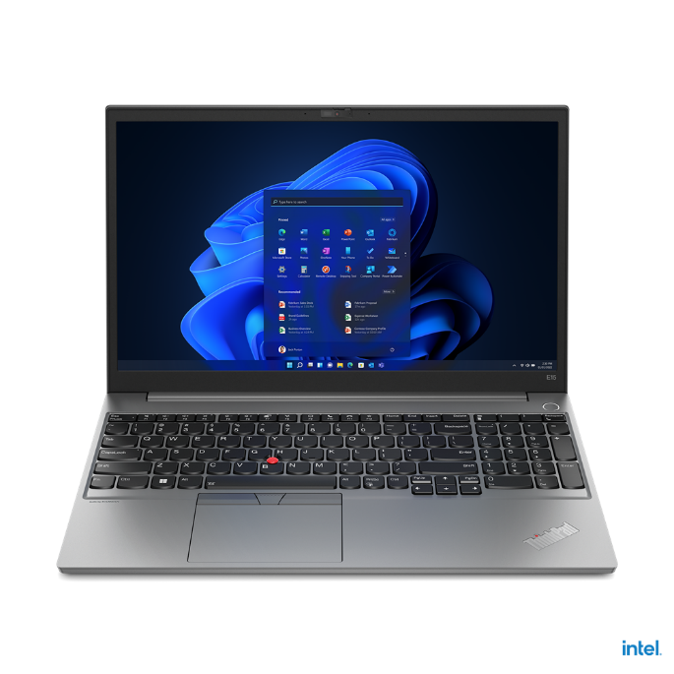

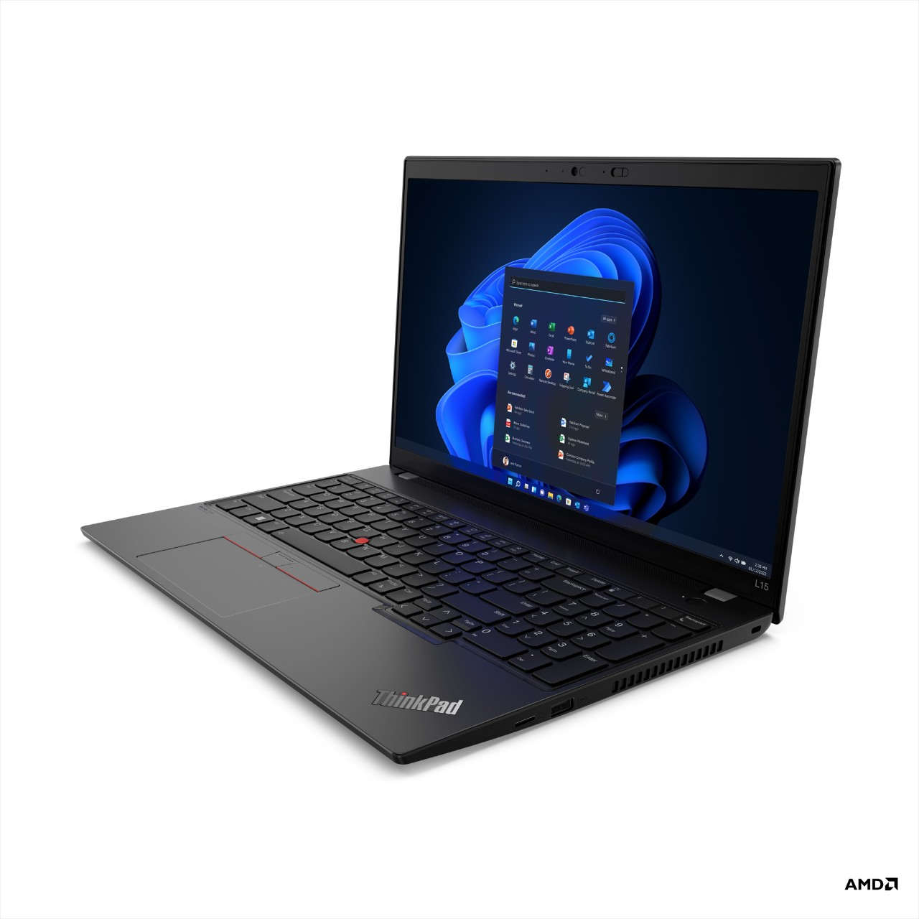
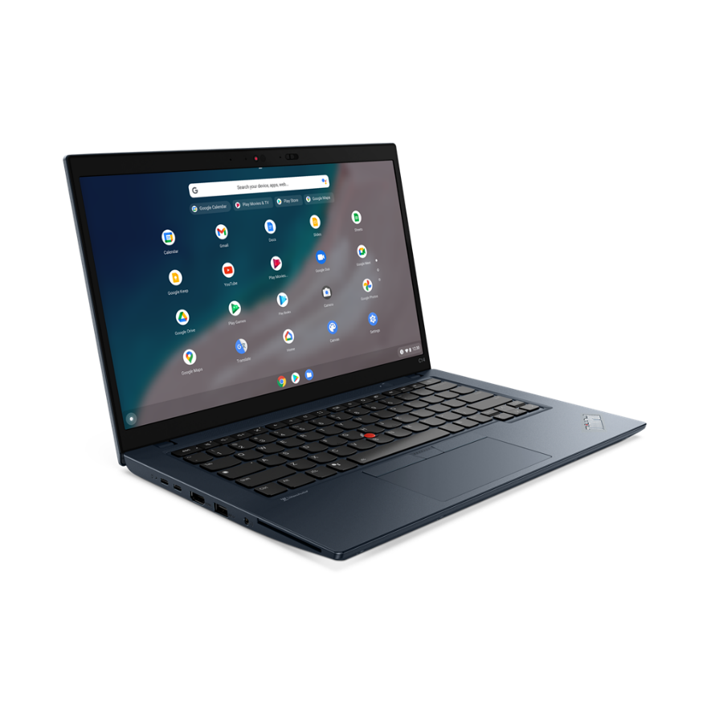
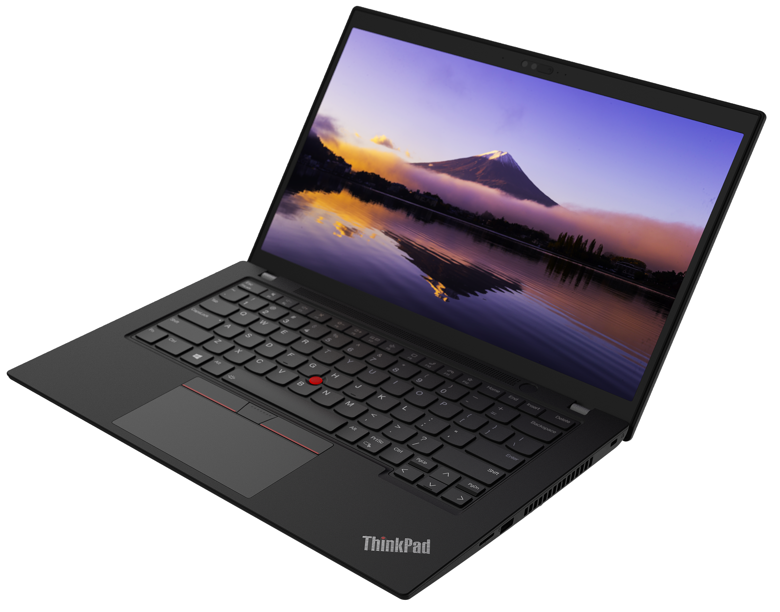
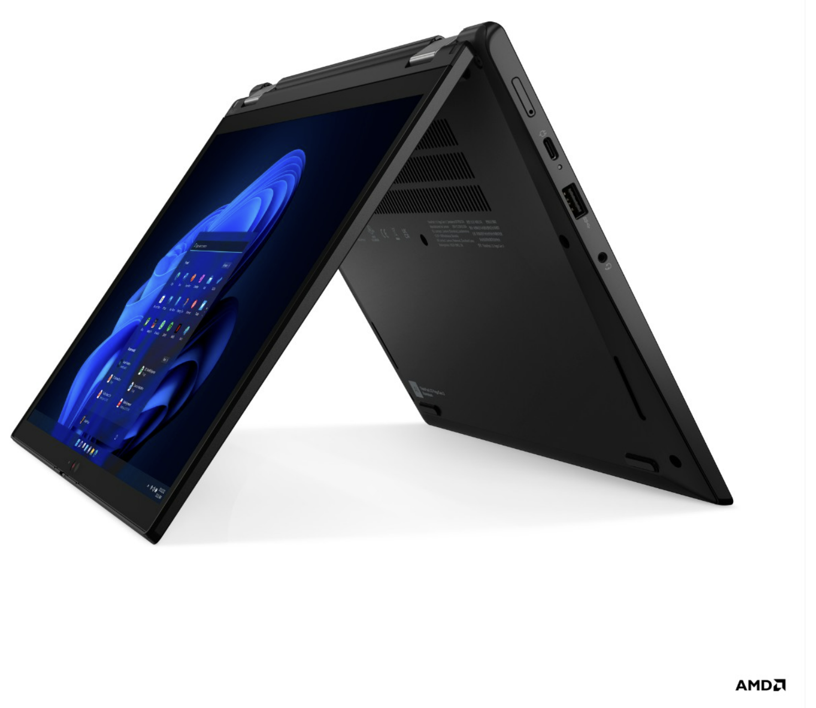
THINKPAD VELOCITY TOPSELLER NOTEBOOKS
[ 1 OF 3 ]
E14 (Intel / AMD)
L15 (Intel / AMD)
E15 (Intel/AMD)
L14 (Intel / AMD)
C14 (Chrome)
L13 Yoga

Slide 8

THINKPAD VELOCITY TOPSELLER NOTEBOOKS
E Series
[ 2 OF 3 ]
E14 G4 – Intel | $1289 Rebate $25 | $1359 Rebate $50 | $1629 Rebate $40
 | 21E3008HUS | 21E3008FUS | 21E3008BUS
 | Core i5-1235U | Core i5-1235U | Core i7-1255U
 | 8GB DIMM | 8GB DIMM + 8GB DIMM | 8GB DIMM + 8GB DIMM
 | 256GB SSD NVMe | 256GB SSD NVMe | 512GB SSD NVMe
 | 14” FHD IPS Anti-glare | 14” FHD IPS Anti-glare | 14” FHD IPS Anti-glare
 | Camera w/Shutter, 2x2 AX WLAN, BT | Camera w/Shutter, 2x2 AX WLAN, BT | Camera w/Shutter, 2x2 AX WLAN, BT
 | Integrated 57Whr Battery | Integrated 57Whr Battery | Integrated 57Whr Battery
 | Win11 Pro DG Win10 | Win11 Pro DG Win10 | Win11 Pro DG Win10
 | 1 Year Depot | 1 Year Depot | 1 Year Depot
E15 G4 – Intel | $1279 Rebate $20 | $1279 | $1359 Rebate $50 | $1619 Rebate $50
 | 21E6007FUS | 21E6007BUS | 21E6007DUS | 21E6007GUS
 | 21E6007FCA | 21E6007BCA | 21E6007DCA | 21E6007GCA
 | Core i5-1235U | Core i5-1235U | Core i7-1255U | Core i7-1255U
 | 8GB DIMM | 8GB DIMM | 8GB DIMM + 8GB DIMM | 8GB DIMM + 8GB DIMM
 | 256GB SSD NVMe | 256GB SSD NVMe | 256GB SSD NVMe | 512GB SSD NVMe
 | 15.6” FHD IPS Anti-glare | 15.6” FHD IPS Anti-glare | 15.6” FHD IPS Anti-glare | 15.6” FHD IPS Anti-glare
 | Camera w/Shutter, 2x2 AX WLAN, BT | Camera w/Shutter, 2x2 AX WLAN, BT | Camera w/Shutter, 2x2 AX WLAN, BT | Camera w/Shutter, 2x2 AX WLAN, BT
 | Integrated 45Whr Battery | Integrated 45Whr Battery | Integrated 45Whr Battery | Integrated 45Whr Battery
 | Win11 Pro DG Win10 | Win11 Pro | Win11 Pro DG Win10 | Win11 Pro
 | 1 Year Depot | 1 Year Depot | 1 Year Depot | 1 Year Depot
E14 (Intel/AMD)
E14 G4 – AMD | $1119 Rebate $80 | $1199 Rebate $55
 | 21EB001PUS | 21EB001RUS
 | 21EB001PCA | 21EB001RCA
 | Ryzen 5 5625U | Ryzen 5 5625U
 | 8GB DIMM | 8GB DIMM + 8GB DIMM
 | 256GB SSD NVMe | 256GB SSD NVMe
 | 14” FHD IPS Anti-glare | 14” FHD IPS Anti-glare
 | Camera w/Shutter, 2x2 AX WLAN, BT | Camera w/Shutter, 2x2 AX WLAN, BT
 | Integrated 45Whr Battery | Integrated 45Whr Battery
 | Win11 Pro DG Win10 | Win11 Pro DG Win10
 | 1 Year Depot | 1 Year Depot
E15 G4 – AMD | $1119 Rebate $40 | $1279 Rebate $50 | $1289 | $1459 Rebate $80
 | 21ED003WUS | 21ED0041US | 21ED003YUS | 21ED0043US
 | 21ED003WCA | 21ED0041CA | 21ED003YCA | 21ED0043CA
 | Ryzen 5 5625U | Ryzen 7 5825U | Ryzen 5 5625U | Ryzen 7 5825U
 | 8GB DIMM | 8GB DIMM | 8GB DIMM + 8GB DIMM | 8GB DIMM + 8GB DIMM
 | 256GB SSD NVMe | 256GB SSD NVMe | 512GB SSD NVMe | 512GB SSD NVMe
 | 15.6” FHD IPS Anti-glare | 15.6” FHD IPS Anti-glare | 15.6” FHD IPS Anti-glare | 15.6” FHD IPS Anti-glare
 | Camera w/Shutter, 2x2 AX WLAN, BT | Camera w/Shutter, 2x2 AX WLAN, BT | Camera w/Shutter, 2x2 AX WLAN, BT | Camera w/Shutter, 2x2 AX WLAN, BT
 | Integrated 45Whr Battery | Integrated 45Whr Battery | Integrated 45Whr Battery | Integrated 45Whr Battery
 | Win11 Pro DG Win10 | Win11 Pro DG Win10 | Win11 Pro DG Win10 | Win11 Pro DG Win10
 | 1 Year Depot | 1 Year Depot | 1 Year Depot | 1 Year Depot
E15 (Intel/AMD)

Slide 9
THINKPAD VELOCITY TOPSELLER NOTEBOOKS
L Series & Chrome
[ 3 OF 3 ]
L13 Yoga – Intel | $2159
 | 21B5003XUS
 | 21B5003XCA
 | Core i7-1255U
 | 16GB DIMM
 | 512GB SSD NVMe
 | 13.3” WUXGA IPS Anti-glare Touch
 | IR Camera w/Shutter, FPR, 2x2 AX WLAN, BT, Backlit Keyboard, Grey
 | Integrated 46Whr Battery
 | Win11 Pro DG Win10
 | 1 Year Depot
L14 G3 - Intel | $1439 | $1999
 | 21C1004JUS | 21C1004NUS
 | 21C1004JCA | 21C1004NCA
 | Core i5-1235U | Core i7-1270P
 | 8GB DIMM | 16GB DIMM
 | 256GB SSD NVMe | 512GB SSD NVMe
 | 14” FHD IPS Anti-glare | 14” FHD IPS Anti-glare
 | Camera w/Shutter, 2x2 AX WLAN, BT | IR Camera w/Shutter, FPR, 2x2 AX WLAN, BT, Backlit Keyboard
 | Integrated 42Whr Battery | Integrated 42Whr Battery
 | Win11 Pro DG Win10 | Win11 Pro DG Win10
 | 1 Year Depot | 1 Year Depot
L15 G3 - Intel | $1499 | $1959
 | 21C30050US | 21C3004VUS
 | 21C30050CA | 21C3004VCA
 | Core i5-1235U | Core i7-1255U
 | 8GB DIMM | 16GB DIMM
 | 256GB SSD NVMe | 512GB SSD NVMe
 | 15.6” FHD IPS Anti-glare, Touch | 15.6” FHD IPS Anti-glare
 | Camera w/Shutter, 2x2 AX WLAN, BT | IR Camera w/Shutter, FPR, 2x2 AX WLAN, BT, Backlit Keyboard
 | Integrated 42Whr Battery | Integrated 42Whr Battery
 | Win11 Pro DG Win10 | Win11 Pro DG Win10
 | 1 Year Depot | 1 Year Depot
L15 (Intel / AMD)
L13 Yoga
L14 G3 – AMD | $1359
 | 21C50015US
 | 21C50015CA
 | Ryzen 5 5675U
 | 8GB DIMM
 | 256GB SSD NVMe
 | 14” FHD IPS Anti-glare
 | Camera w/Shutter, 2x2 AX WLAN, BT
 | Integrated 42Whr Battery
 | Win11 Pro DG Win10
 | 1 Year Depot
L15 G3 – AMD | $1439 Rebate $200
 | 21C70010US
 | 21C70010CA
 | Ryzen 5 5675U
 | 8GB DIMM
 | 256GB SSD NVMe
 | 15.6” FHD IPS Anti-glare, Touch
 | IR Camera w/Shutter, 2x2 AX WLAN, BT
 | Integrated 42Whr Battery
 | Win11 Pro DG Win10
 | 1 Year Depot
C14 Gen1 (Chrome) | $1449
 | 21C9000HUS
 | 21C9000HCZ
 | Core i5-1245U
 | 8GB DIMM
 | 256GB SSD NVMe
 | 14” FHD IPS Anti-glare
 | Camera w/Shutter, FPR, 2x2 AX WLAN, BT, Backlit Keyboard, Abyss Blue
 | Integrated 57Whr Battery
 | ChromeOS
 | 1 Year Depot
L14 (Intel / AMD)
C14 (Chrome)

Slide 10
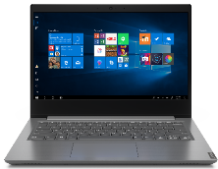
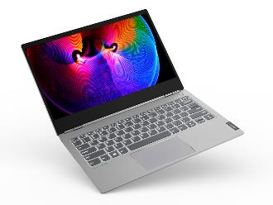
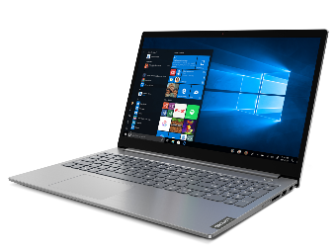
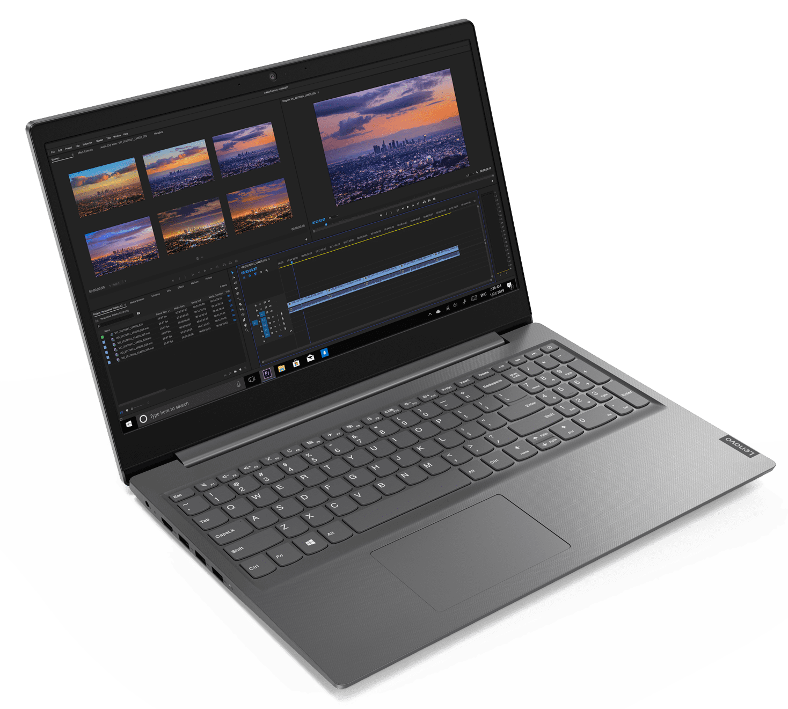
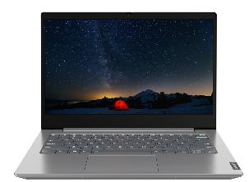
LENOVO TOPSELLER NOTEBOOKS
[ 1 OF 3 ]
Lenovo V14
ThinkBook 13s
ThinkBook 15
Lenovo V15
ThinkBook 14

Slide 11
LENOVO TOPSELLER
V Series
[ 2 OF 3 ]
Lenovo V14 G3 -- AMD | $889
 | 82TU0004US
 | 82TU0005CA
 | Ryzen 5 5625U
 | 8GB DIMM
 | 256GB PCIe SSD
 | 14” FHD TN Anti-glare
 | Camera w/Shutter 2x2 AX WLAN-BT
 | Integrated 38Whr Battery
 | Win 11 Pro
 | 1 Year Depot
Lenovo V14 G3 -- Intel | $899
 | 82TS005QUS
 | 82TS005PCA
 | Core i5-1235U
 | 8GB DIMM
 | 256GB PCIe SSD
 | 14” FHD TN Anti-glare
 | Camera w/Shutter 2x2 AX WLAN-BT
 | Integrated 38Whr Battery
 | Win 11 Pro
 | 1 Year Depot
Lenovo V15 G3 -- AMD | $889 Rebate $15
 | 82TV001QUS
 | 82TV001RCA
 | Ryzen 5 5625U
 | 8GB DIMM
 | 256GB PCIe SSD
 | 15.6” FHD TN Anti-glare
 | Camera w/Shutter 2x2 AX WLAN-BT
 | 4 Cell 56Whr Battery
 | Win 11 Pro
 | 1 Year Depot
Lenovo V15 G3 -- Intel | $909
 | 82TT005GUS
 | 82TT005HCA
 | Core i5-1235U
 | 8GB DIMM
 | 256GB PCIe SSD
 | 15.6” FHD TN Anti-glare
 | Camera w/Shutter 2x2 AX WLAN-BT
 | 4 Cell 56Whr Battery
 | Win 11 Pro
 | 1 Year Depot

Slide 12
LENOVO TOPSELLER
ThinkBook
[ 3 OF 3 ]
ThinkBook 13s G4 - AMD | $1539
 | 21AS003DUS
 | 21AS003ECA
 | Ryzen 7 6800U
 | 16GB DIMM
 | 512GB PCIe SSD
 | 13.3” WQXGA IPS Anti-glare
 | Camera w/Shutter, FPR, 2x2 AX WLAN, BT, Backlit Keyboard, Aluminum
 | Integrated 56Whr Battery
 | Win11 Pro DG Win10
 | 1 Year Depot
ThinkBook 13s G4 - Intel | $1709
 | 21AR006JUS
 | 21AR006KCA
 | Core i7-1260P
 | 16GB DIMM
 | 512GB PCIe SSD
 | 13.3” WQXGA IPS Touch
 | Camera w/Shutter, FPR, 2x2 AX WLAN, BT, Backlit Keyboard, Aluminum
 | Integrated 56Whr Battery
 | Win11 Pro DG Win10
 | 1 Year Depot
ThinkBook 13x G2 | $1809 | $1929
 | 21AT000XUS | 21AT0012US
 | 21AT000YCA | 21AT0013CA
 | Core i5-1235U | Core i7-1255U
 | 16GB DIMM | 16GB DIMM
 | 512GB SSD NVMe | 512GB SSD NVMe
 | 13.3” WQXGA IPS Touch | 13.3” WQXGA IPS Touch
 | Camera w/Shutter, FPR, 2x2 AX WLAN, BT, Backlit Keyboard, Aluminum | Camera w/Shutter, FPR, 2x2 AX WLAN, BT, Backlit Keyboard, Aluminum
 | Integrated 56Whr Battery | Integrated 56Whr Battery
 | Win 11 Pro | Win 11 Pro
 | 1 Year Depot | 1 Year Depot
ThinkBook 14 Gen4 - Intel | $1199 Rebate $50 | $1489 Rebate $75
 | 21DH000RUS | 21DH00DCUS
 | 21DH000SCA | 21DH00DDCA
 | Core i5-1235U | Core i7-1255U
 | 8GB DIMM | 8GB DIMM
 | 256GB SSD NVMe | 512GB SSD NVMe
 | 14” FHD IPS Anti-glare | 14” FHD IPS Anti-glare Touch
 | Camera w/Shutter, FPR, 2x2 AX WLAN, BT, Backlit Keyboard, Aluminum | Camera w/Shutter, FPR, 2x2 AX WLAN, BT, Backlit Keyboard, Aluminum
 | Integrated 45Whr Battery | Integrated 45Whr Battery
 | Win11 Pro | Win11 Pro DG Win10
 | 1 Year Depot | 1 Year Depot
ThinkBook 14 Gen4 - AMD | $1149 Rebate $25 | $1299 Rebate $40
 | 21DK004YUS | 21DK0051US
 | 21DK0050CA | 21DK0052CA
 | Ryzen 5 5625U | Ryzen 7 5825U
 | 8GB DIMM | 8GB DIMM
 | 256GB SSD NVMe | 512GB SSD NVMe
 | 14” FHD IPS Anti-glare | 14” FHD IPS Anti-glare
 | Camera w/Shutter, FPR, 2x2 AX WLAN, BT, Backlit Keyboard, Aluminum | Camera w/Shutter, FPR, 2x2 AX WLAN, BT, Backlit Keyboard, Aluminum
 | Integrated 45Whr Battery | Integrated 45Whr Battery
 | Win11 Pro DG Win10 | Win11 Pro DG Win10
 | 1 Year Depot | 1 Year Depot
ThinkBook 14s Gen2 | $1379 | $1639
 | 21DM003LUS | 21DM003NUS
 | 21DM003MCA | 21DM003PCA
 | Core i5-1235U | Core i7-1255U
 | 8GB DIMM | 8GB DIMM
 | 256GB SSD NVMe | 512GB SSD NVMe
 | 14” FHD IPS Anti-glare Touch | 14” FHD IPS Anti-glare Touch
 | Camera w/Shutter, FPR, 2x2 AX WLAN, BT, Backlit Keyboard, Aluminum | Camera w/Shutter, FPR, 2x2 AX WLAN, BT, Backlit Keyboard, Aluminum
 | Integrated 60Whr Battery | Integrated 60Whr Battery
 | Win11 Pro DG Win10 | Win11 Pro DG Win10
 | 1 Year Depot | 1 Year Depot
ThinkBook 15 Gen4 - Intel | $1199 Rebate $40 | $1299 | $1379 Rebate $75 | $1489 Rebate $50
 | 21DJ00G1US | 21DJ00G7US | 21DJ00G3US | 21DJ00G5US
 | 21DJ00G2CA | 21DJ00G8CA | 21DJ00G4CA | 21DJ00G6CA
 | Core i5-1235U | Core i5-1235U | Core i7-1255U | Core i7-1255U
 | 8GB DIMM | 8GB DIMM | 8GB DIMM | 8GB DIMM
 | 256GB SSD NVMe | 256GB SSD NVMe | 512GB SSD NVMe | 512GB SSD NVMe
 | 15.6” FHD IPS Anti-glare | 15.6” FHD IPS Anti-glare Touch | 15.6” FHD IPS Anti-glare | 15.6” FHD IPS Anti-glare, Touch
 | Camera w/Shutter, FPR, 2x2 AX WLAN, BT, Backlit Keyboard, Aluminum/ABS | Camera w/Shutter, FPR, 2x2 AX WLAN, BT, Backlit Keyboard, Aluminum/ABS | Camera w/Shutter, FPR, 2x2 AX WLAN, BT, Backlit Keyboard, Aluminum/ABS | Camera w/Shutter, FPR, 2x2 AC WLAN, BT, Backlit Keyboard, Aluminum/ABS
 | Integrated 45Whr Battery | Integrated 45Whr Battery | Integrated 45Whr Battery | Integrated 45Whr Battery
 | Win11 Pro DG Win10 | Win11 Pro DG Win10 | Win11 Pro DG Win10 | Win11 Pro DG Win10
 | 1 Year Depot | 1 Year Depot | 1 Year Depot | 1 Year Depot
ThinkBook 15 Gen4 - AMD | $1199 | $1299
 | 21DL0053US | 21DL0051US
 | 21DL0054CA | 21DL0052CA
 | Ryzen 5 5625U | Ryzen 7 5825U
 | 8GB DIMM | 8GB DIMM
 | 256GB SSD NVMe | 512GB SSD NVMe
 | 15.6” FHD IPS Anti-glare, Touch | 15.6” FHD IPS Anti-glare
 | Camera w/Shutter, FPR, 2x2 AX WLAN, BT, Backlit Keyboard, Aluminum/ABS | Camera w/Shutter, FPR, 2x2 AX WLAN, BT, Backlit Keyboard, Aluminum/ABS
 | Integrated 45Whr Battery | Integrated 45Whr Battery
 | Win11 Pro DG Win10 | Win11 Pro DG Win10
 | 1 Year Depot | 1 Year Depot

Slide 13
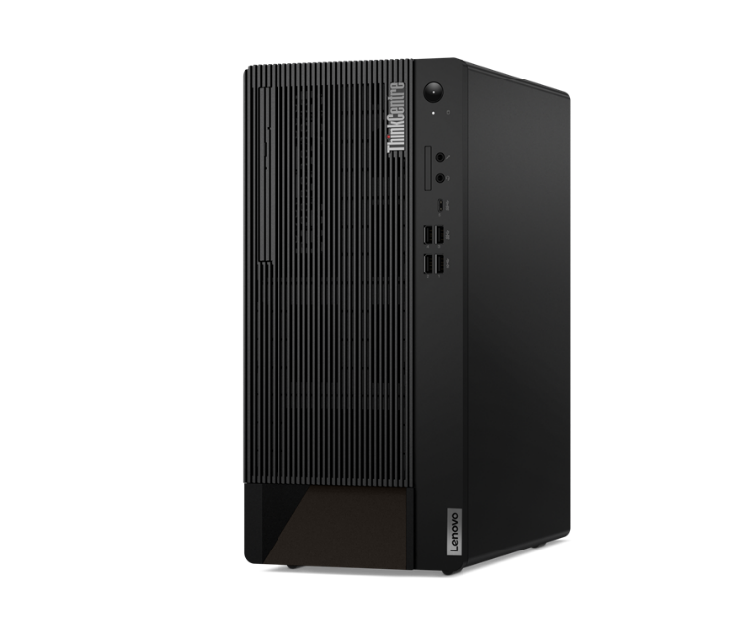
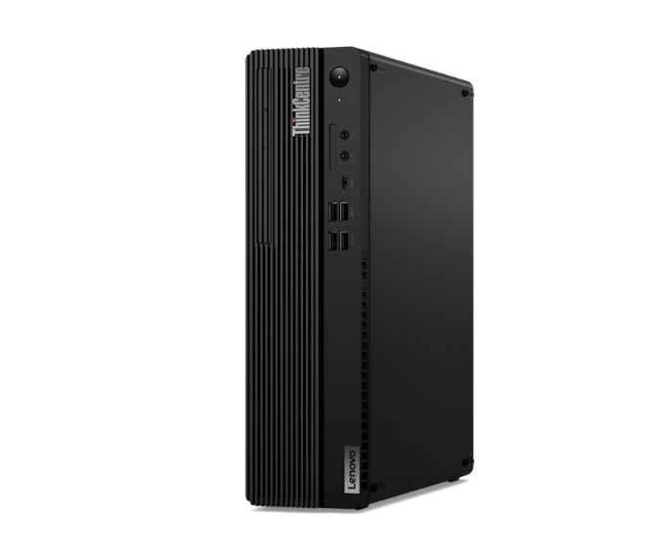
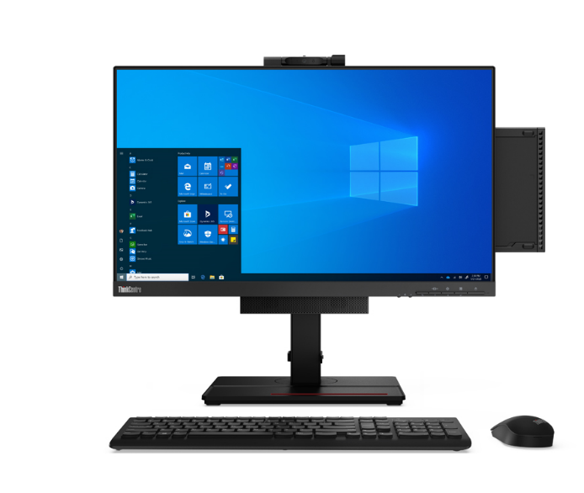
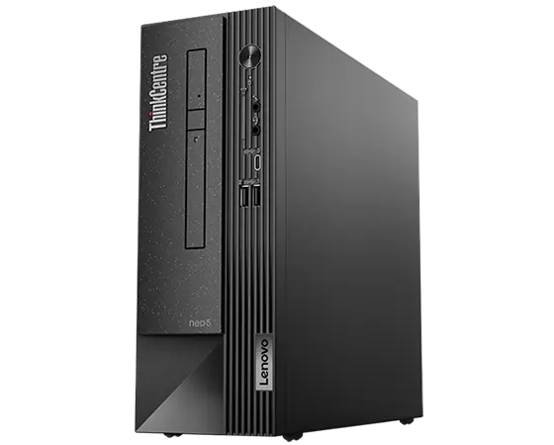
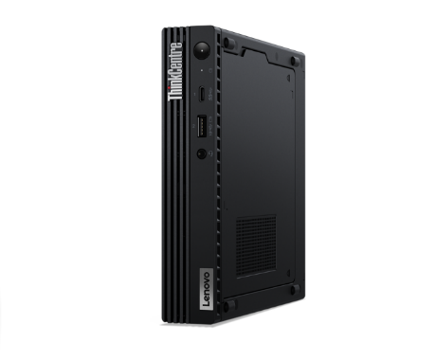
LENOVO TOPSELLER
ThinkCentre & Lenovo Desktops
[ 1 OF 5 ]
ThinkCentre M75q Gen 2 Tiny (Pictured with optional Tiny-in-One)
ThinkCentre Tower
(M70t/M80t/M90t)
ThinkCentre
Small Form Factor
(M70s/M75s/M80s/M90s)
ThinkCentre Neo Small Form Factor
(Neo50s)
ThinkCentre Tiny
(M60eM70q/M75q/M80q/M90q)

Slide 14
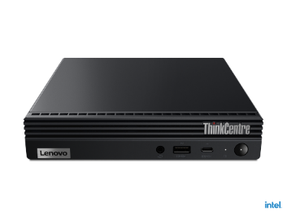

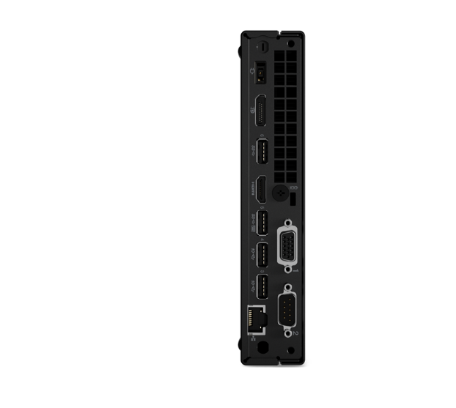
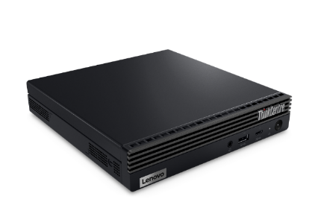
LENOVO TOPSELLER
ThinkCentre Tiny AMD & Intel Desktops
[ 2 OF 5 ]
M75q Tiny Gen 2 | $1029 | $1129 Rebate $35 | $1369
 | 11JN0074US | 11JN006RUS | 11JN0072US
 | 11JN007CCA | 11JN0076CA | 11JN007DCA
 | Ryzen 5 Pro 5650GE | Ryzen 5 Pro 5650GE | Ryzen 7 Pro 5750GE
 | 8GB Memory | 16GB Memory | 16GB Memory
 | 128GB SSD M.2 PCIe | 256GB SSD M.2 PCIe | 512GB SSD M.2 PCIe
 | Win11 Pro DG Win10 | Win11 Pro DG Win10 | Win11 Pro DG Win10
 | 3 Year Onsite | 3 Year Onsite | 3 Year Onsite
M70q Tiny Gen 1 | $829 Rebate $55 | $869 Rebate $55 | $899 Rebate $25 | $1079 Rebate $40
 | 11DT00FGUS | 11DT00FFUS | 11DT00FEUS | 11DT00FJUS
 | 11DT00FGCA | 11DT00FFCA | 11DT00FECA | 11DT00FJCA
 | Core i5-10400T | Core i5-10400T | Core i5-10400T | Core i7-10700T
 | 8GB Memory | 16GB Memory | 16GB Memory | 16GB Memory
 | 256GB SSD M.2 PCIe | 256GB SSD M.2 PCIe | 512GB SSD M.2 PCIe | 256GB SSD M.2 PCIe
 | Win11 Pro DG Win10 | Win11 Pro DG Win10 | Win11 Pro DG Win10 | Win11 Pro DG Win10
 | 3 Year Onsite | 3 Year Onsite | 3 Year Onsite | 3 Year Onsite
ThinkCentre M70q Tiny
[ 2 OF 3 ]
M60e Tiny | $929 Rebate $50 | $999
 | 11LV008SUS | 11LV008RUS
 | 11LV008SCA | 11LV008RCA
 | Core i5-1035G1 | Core i5-1035G1
 | 8GB Memory | 16GB Memory
 | 256GB M.2 SSD | 256GB M.2 SSD
 | 2x2 AC Wi-Fi + BT 5.2 | 2x2 AC Wi-Fi + BT 5.2
 | DP + HDMI | DP + HDMI
 | Win11 Pro DG Win10 | Win11 Pro DG Win10
 | 1 Year Onsite | 1 Year Onsite
M80q Tiny Gen 1 | $959 Rebate $25 | $999 Rebate $25 | $1259
 | 11DN008XUS | 11DN008YUS | 11DN0090US
 | 11DN008XCA | 11DN008YCA | 11DN0090CA
 | Core i5-10500T | Core i5-10500T | Core i7-10700T
 | 8GB Memory | 16GB Memory | 16GB Memory
 | 256GB SSD M.2 PCIe | 256GB SSD M.2 PCIe | 256GB SSD M.2 PCIe
 | Win11 Pro DG Win10 | Win11 Pro DG Win10 | Win11 Pro DG Win10
 | 3 Year Onsite | 3 Year Onsite | 3 Year Onsite
ThinkCentre M80q Tiny

Slide 15
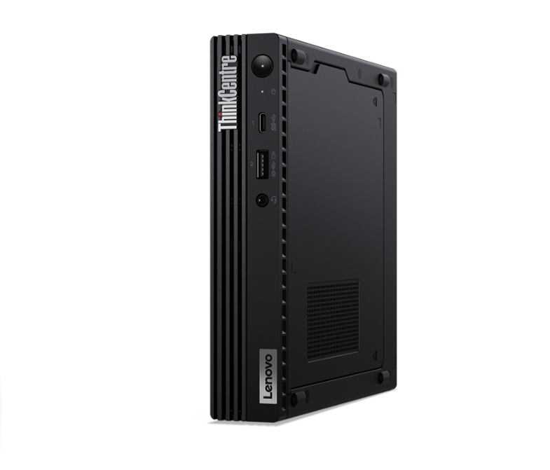
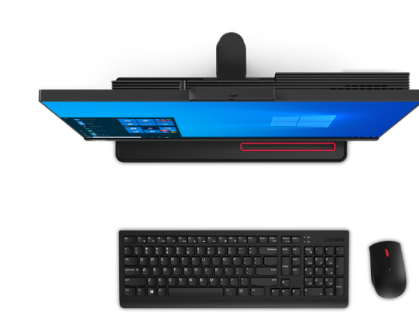
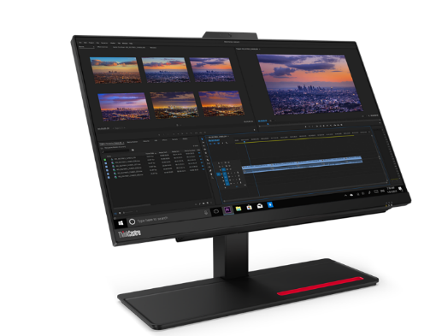
LENOVO TOPSELLER
ThinkCentre Adlerlake Tiny & AIO Desktops
[ 3 OF 5 ]
M70q Tiny Gen 3 | $1199 | $1259 | $1649 Rebate $60
 | 11T3008EUS | 11T300A4US | 11T30080US
 | 11T3008ECA | 11T300A4CA | 11T30080CA
 | Core i5-12400T | Core i5-12400T | Core i7-12700T
 | 8GB Memory | 16GB Memory | 16GB Memory
 | 256GB SSD M.2 PCIe | 256GB SSD M.2 PCIe | 512GB SSD M.2 PCIe
 | Win11 Pro DG Win10 | Win11 Pro DG Win10 | Win11 Pro DG Win10
 | 3 Year Onsite | 3 Year Onsite | 3 Year Onsite
M80q Tiny Gen 3 | $1339 | $1839
 | 11U1004XUS | 11U1004GUS
 | 11U1004XCA | 11U1004GCA
 | Core i5-12500T | Core i7-12700T
 | 16GB Memory | 16GB Memory
 | 256GB SSD M.2 PCIe | 512GB SSD M.2 PCIe
 | Win11 Pro DG Win10 | Win11 Pro DG Win10
 | 3 Year Onsite | 3 Year Onsite
M90q Tiny Gen 3 | $1579 | $2049
 | 11U50051US | 11U5005TUS
 | 11U50051CA | 11U5005TCA
 | Core i5-12500T | Core i7-12700T
 | 16GB Memory | 16GB Memory
 | 256GB SSD M.2 PCIe | 512GB SSD M.2 PCIe
 | Win11 Pro DG Win10 | Win11 Pro DG Win10
 | 3 Year Onsite | 3 Year Onsite
ThinkCentre M90q Tiny
[ 2 OF 3 ]
M70a All-in-One Gen 3 | $1809
 | 11VL0040US
 | 11VL0040CA
 | 21.5” 1080p Multi-Touch Display
 | Core i5-12400
 | 8GB Memory
 | 256GB SSD M.2 PCIe NVMe Opal
 | DVD RW, Wi-Fi+BT, Webcam/Mic
 | DP Out, UltraFlex Stand
 | Win11 Pro DG Win10
 | 3 Year Onsite
M90a All-in-One Gen 3 | $2009
 | 11VF0063US
 | 11VF0063CA
 | 23.8” 1080p Multi-Touch Display
 | Core i5-12500
 | 8GB Memory
 | 256GB M.2 PCIe SSD
 | DVD RW, Wi-Fi+BT, Webcam/Mic
 | DP Out, UltraFlex Stand
 | Win11 Pro DG Win10
 | 3 Year Onsite
M90a Pro AIO Gen 3 | $2169
 | 11VA004LUS
 | 11VA0057CA
 | 23.8” QHD-2560p Non-Touch Display
 | Core i5-12450
 | Memory
 | 512GB SSD M.2 PCIe NVMe Opal
 | DVD RW, Wi-Fi+BT, Webcam/Mic
 | DP Out, UltraFlex Stand
 | Win11 Pro DG Win10
 | 3 Year Onsite

Slide 16
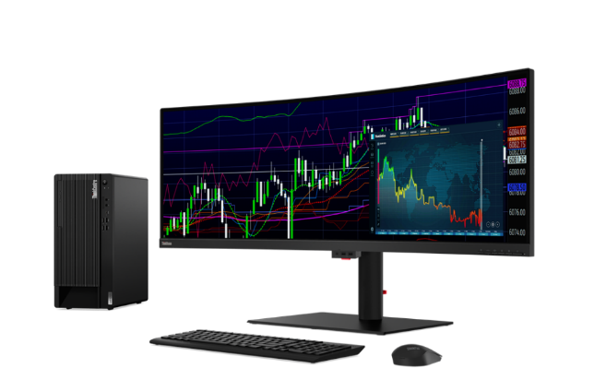
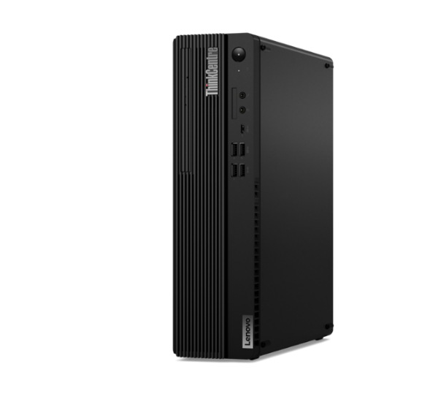
LENOVO TOPSELLER
ThinkCentre Small Form Factor Desktops
[ 4 OF 5 ]
ThinkCentre Neo50s SFF | $1109 | $1119 Rebate $50
 | 11SX005EUS | 11SX005FUS
 | 11SX005ECA | 11SX005FCA
 | Core i5-12400 | Core i5-12400
 | 8GB Memory | 8GB Memory
 | 128GB SSD M.2 PCIe | 256GB SSD M.2 PCIe
 | DVD RW | DVD RW
 | 1 DisplayPort / 1 HDMI | 1 DisplayPort / 1 HDMI
 | Win11 Pro DG Win10 | Win11 Pro DG Win10
 | 3 Year Onsite | 3 Year Onsite
M75s Gen 2 | $1089 | $1419
 | 11R80039US | 11R8003HUS
 | 11R80039CA | 11R8003HCA
 | Ryzen 5 Pro 5650G | Ryzen 7 Pro 5750G
 | 8GB Memory | 16GB Memory
 | 256GB SSD M.2 PCIe | 512GB SSD M.2 PCIe
 | DVD RW | DVD RW
 | 2 DisplayPort / 2 HDMI | 2 DisplayPort / 2 HDMI
 | Win11 Pro DG Win10 | Win11 Pro DG Win10
 | 3 Year Onsite | 3 Year Onsite
ThinkCentre M80s SFF
(monitor not included)
ThinkCentre Neo50s SFF
M70s Gen 3 | 1319 Rebate $100 | $1749
 | 11T8003CUS | 11T8002YUS
 | 11T8003FCA | 11T8002YCA
 | Core i5-12400 | Core i7-12700
 | 16GB Memory | 16GB Memory
 | 256GB SSD M.2 PCIe | 512GB SSD M.2 PCIe
 | DVD RW | DVD RW
 | 2 DisplayPort / 2 HDMI | 2 DisplayPort / 2 HDMI
 | Win11 Pro DG Win10 | Win11 Pro DG Win10
 | 3 Year Onsite | 3 Year Onsite
M80s Gen 3 | $1489 | $1859
 | 11TG001MUS | 11TG0020US
 | 11TG002QCA | 11TG002PCA
 | Core i5-12500 | Core i7-12700
 | 16GB Memory | 16GB Memory
 | 512GB SSD M.2 PCIe | 512GB SSD M.2 PCIe
 | DVD RW | DVD RW
 | 2 DisplayPort / 2 HDMI | 2 DisplayPort / 2 HDMI
 | Win11 Pro DG Win10 | Win11 Pro DG Win10
 | 3 Year Onsite | 3 Year Onsite

Slide 17
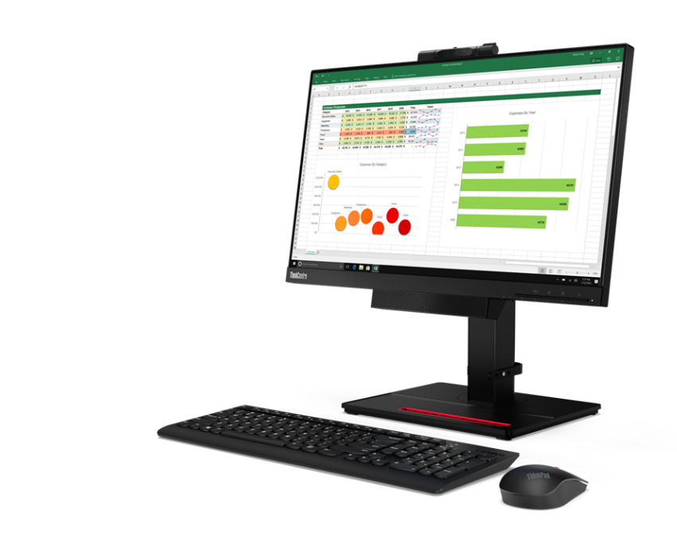

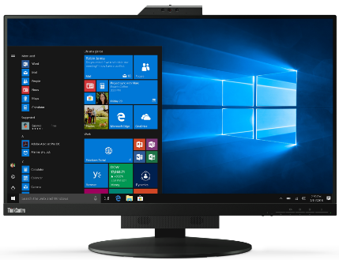




LENOVO TOPSELLER
ThinkCentre Tiny-in-One Monitors
[ 5 OF 5 ]
ThinkCentre Tiny-in-One 27
TINY-IN-ONE 4
Price is Monitor Only.
ThinkCentre Tiny (Pictured) Sold Separately
ThinkCentre Tiny-in-One 22
Tiny-in-One 22 Monitor | $396.44
 | 11GSPAR1US
 | 21.5” WLED Borderless Panel
 | 1080p Non-Touch Display
 | 720p Webcam w/ Dual Mic and ThinkShutter Cover
 | 1 x USB Type A port (Side)
 | Tiny PC Compatibility (AIO Mode)
 | DisplayPort In (Monitor Mode)
 | Lift / Tilt / Pivot Stand Adjustment
 | 3 Year Adv. Exchange Warranty
Tiny-in-One 24 Monitor | $428.24
 | 11GDPAR1US
 | 23.8” WLED Borderless Panel
 | 1080p Non-Touch Display
 | 1080p Webcam w/ Dual Mic
 | 1 x USB Type A port (Side)
 | Tiny PC Compatibility (AIO Mode)
 | DisplayPort In (Monitor Mode)
 | Lift / Tilt / Pivot Stand Adjustment
 | 3 Year Adv. Exchange Warranty
Tiny-in-One 27 Monitor | $608.44
 | 11JHRAR1US
 | 27” WLED Borderless Panel
 | 1440p Non-Touch Display
 | 1080p RGB/IR Webcam w/ Dual Mic
 | 2 x USB 3.1 port (Side)
 | Tiny PC Compatibility (AIO Mode)
 | DisplayPort / HMDI In (Monitor Mode)
 | Lift / Tilt / Pivot Stand Adjustment
 | 3 Year Adv. Exchange Warranty
Tiny-in-One 24 Touch Monitor | $523.64
 | 11GCPAR1US
 | 23.8” WLED Borderless Panel
 | 1080p Touch Display
 | 720p Webcam w/ Dual Mic
 | 1 x USB A port (Side)
 | Tiny PC Compatibility (AIO Mode)
 | DisplayPort In (Monitor Mode)
 | Lift / Tilt / Pivot Stand Adjustment
 | 3 Year Adv. Exchange Warranty

Slide 18
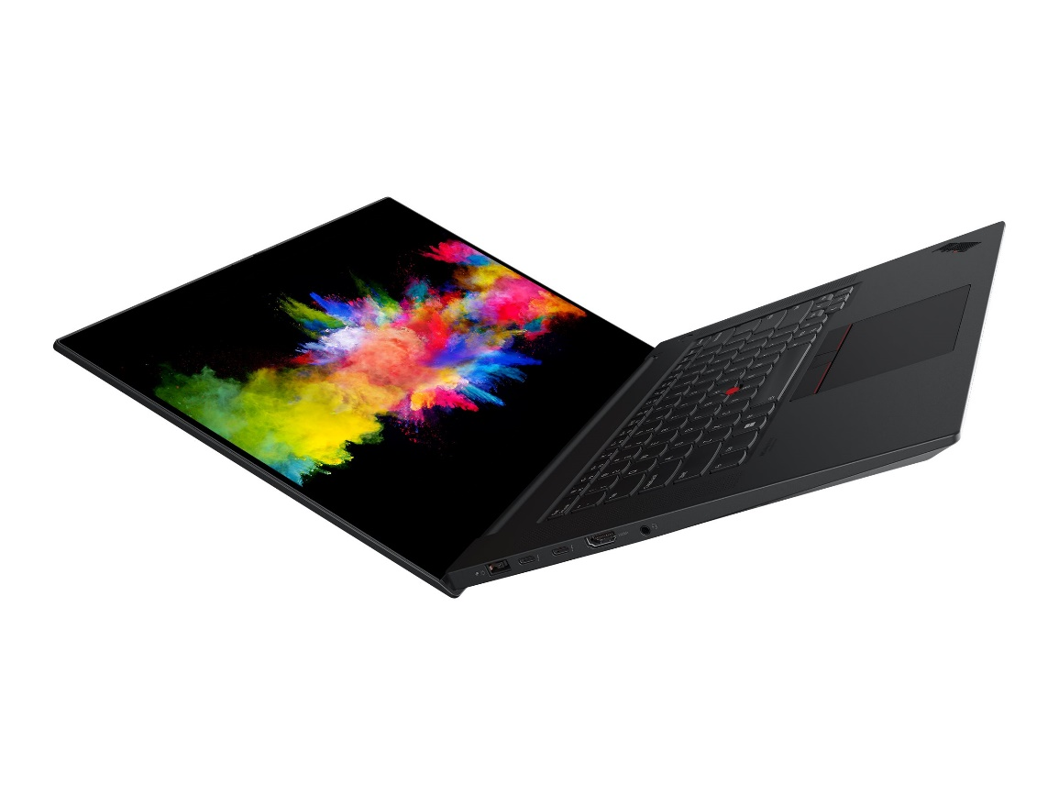
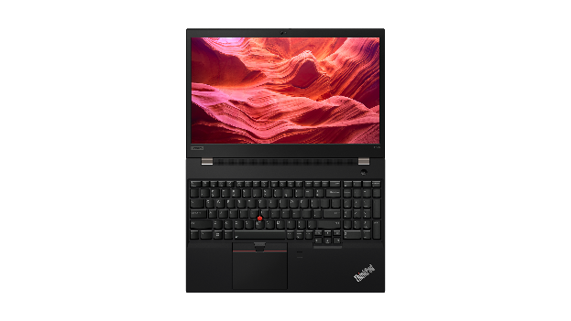
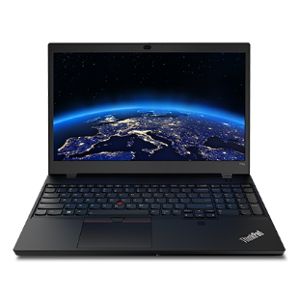
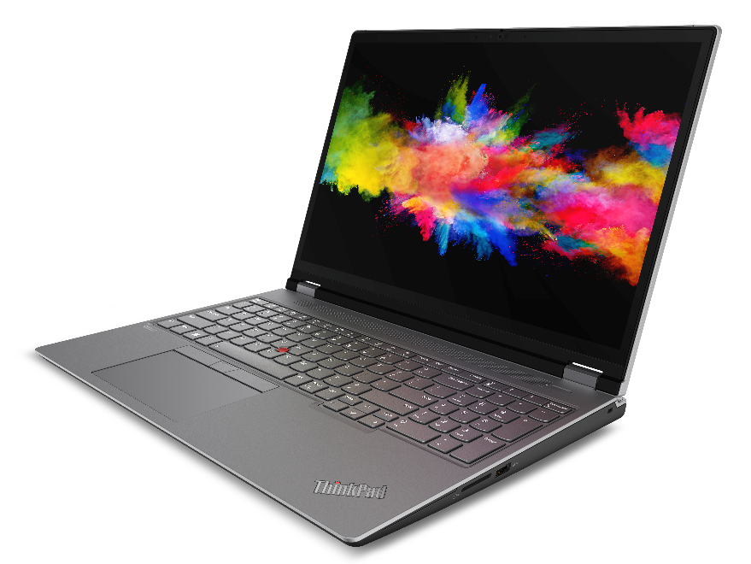
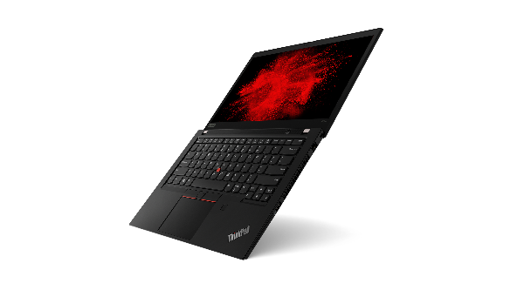
LENOVO TOPSELLER
ThinkPad Mobile Workstations
[ 1 OF 3 ]
P15v / T15p
P1
P16s Gen1 (Intel / AMD)
P14s Gen1 (Intel / AMD)
P16 Gen1

Slide 19
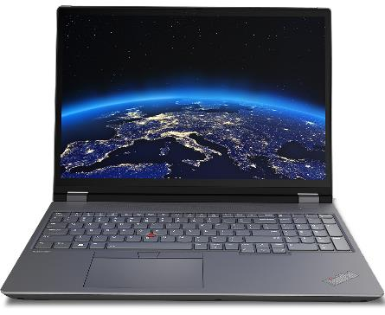
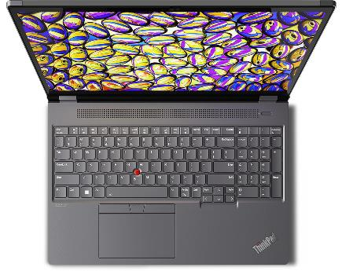
THINKPAD TOPSELLER
Mobile Workstations - Intel
[ 2 OF 3 ]
P1 Gen 5 | $3949 Rebate $100 | $4269 Rebate $100
 | 21DC003YUS | 21DC004JUS
 | 21DC003YCA | 21DC004JCA
 | Core i7-12800H | Core i7-12700H
 | 16GB DIMM | 2x 16GB DIMM
 | 512GB SSD NVMe | 1TB SSD NVMe
 | 16” WQXGA IPS Anti-glare, 100% sRGB | 16” WQXGA IPS Anti-glare, 100% sRGB
 | NVIDIA RTX A1000 | NVIDIA RTX A2000
 | IR Camera w/Shutter, FPR, 2x2 AX WLAN, BT, Backlit Keyboard | IR Camera w/Shutter, FPR, 2x2 AX WLAN, BT, Backlit Keyboard
 | Win11 Pro DG Win10 | Win11 Pro DG Win10
 | 3 Year Premier | 3 Year Premier
P16 Gen 1 | $3589 Rebate $200 | $4239 Rebate $200 | $4419
 | 21D6005MUS | 21D6005QUS | 21D6006PUS
 | 21D6005MCA | 21D6005QCA | 21D6006PCA
 | Core i7-12800HX | Core i7-12800HX | Core i7-12850HX
 | 2x 8GB DIMM | 2x 16GB DIMM | 2x 16GB DIMM
 | 512GB SSD NVMe | 1TB SSD NVMe | 1TB SSD NVMe
 | 16” WQXGA IPS Anti-glare, 100% sRGB | 16” WQXGA IPS Anti-glare, 100% sRGB | 16” WQXGA IPS Anti-glare, 100% sRGB
 | NVIDIA RTX A1000 | NVIDIA RTX A2000 | NVIDIA RTX A2000
 | IR Camera w/Shutter, FPR, 2x2 AX WLAN, BT, Backlit Keyboard | IR Camera w/Shutter, FPR, 2x2 AX WLAN, BT, Backlit Keyboard | IR Camera w/Shutter, FPR, 2x2 AX WLAN, BT, Backlit Keyboard
 | Win11 Pro DG Win10 | Win11 Pro DG Win10 | Win11 Pro DG Win10
 | 3 Year Premier | 3 Year Premier | 3 Year Premier
P16s Gen 1 - Intel | $2859 Rebate $200 | $3159 Rebate $200 | $3609 Rebate $200
 | 21BT001QUS | 21BT001GUS | 21BT001NUS
 | 21BT001QCA | 21BT001GCA | 21BT001NCA
 | Core i7-1260P | Core i7-1280P | Core i7-1280P
 | 16GB DIMM | 16GB DIMM | 2x 16GB DIMM
 | 512GB SSD NVMe | 512GB SSD NVMe | 1TB SSD NVMe
 | 16” WQXGA IPS Anti-glare | 16” WQXGA IPS Anti-glare | 16” WQXGA IPS Anti-glare
 | NVIDIA Quadro T550 | NVIDIA Quadro T550 | NVIDIA Quadro T550
 | IR Camera w/Shutter, FPR, 2x2 AX WLAN, BT, Backlit Keyboard | IR Camera w/Shutter, FPR, 2x2 AX WLAN, BT, Backlit Keyboard | IR Camera w/Shutter, FPR, 2x2 AX WLAN, BT, Backlit Keyboard
 | Win11 Pro | Win11 Pro | Win11 Pro
 | 3 Year Premier | 3 Year Premier | 3 Year Premier
P16 Gen1
P14s Gen 3 - Intel | $3129 Rebate $50 | $3359 Rebate $50
 | 21AK002HUS | 21AK0028US
 | 21AK002HCA | 21AK0028CA
 | Core i7-1280P | Core i7-1260P
 | 16GB DIMM | 2x 16GB DIMM
 | 512GB SSD NVMe | 1TB SSD NVMe
 | 14” WQXGA IPS Anti-glare | 14” WQXGA IPS Anti-glare
 | NVIDIA Quadro T550 | NVIDIA Quadro T550
 | IR Camera w/Shutter, FPR, 2x2 AX WLAN, BT, Backlit Keyboard | IR Camera w/Shutter, FPR, 2x2 AX WLAN, BT, Backlit Keyboard
 | Win11 Pro | Win11 Pro
 | 3 Year Premier | 3 Year Premier
P15v Gen 3 - Intel | $2879 Rebate $100 | $2979 Rebate $100 | $3809
 | 21D80033US | 21D8003HUS | 21D8004CUS
 | 21D80033CA | 21D8003HCA | 21D8004CCA
 | Core i7-12700H | Core i7-12700H | Core i7-12800H
 | 16GB DIMM | 16GB DIMM | 2x 16GB DIMM
 | 512GB SSD NVMe | 512GB SSD NVMe | 1TB SSD NVMe
 | 15.6” FHD IPS Anti-glare | 15.6” FHD IPS Anti-glare | 15.6” FHD IPS Anti-glare
 | NVIDIA T600 | NVIDIA T1200 | NVIDIA RTX A2000
 | IR Camera w/Shutter, FPR, 2x2 AX WLAN, BT, Backlit Keyboard | IR Camera w/Shutter, FPR, 2x2 AX WLAN, BT, Backlit Keyboard | IR Camera w/Shutter, FPR, 2x2 AX WLAN, BT, Backlit Keyboard
 | Win11 Pro DG Win10 | Win11 Pro DG Win10 | Win11 Pro DG Win10
 | 3 Year Premier | 3 Year Premier | 3 Year Premier
T15p Gen 3 | $2939 | $3579
 | 21DA0010US | 21DA000XUS
 | 21DA0010CA | 21DA000XCA
 | Core i7-12700H | Core i7-12700H
 | 16GB DIMM | 2x 16GB DIMM
 | 512GB SSD NVMe | 1TB SSD NVMe
 | 15.6” FHD IPS Anti-glare | 15.6” UHD IPS Anti-glare, 100% sRGB
 | NVIDIA GeForce RTX 3050 | NVIDIA GeForce RTX 3050
 | IR Camera w/Shutter, FPR, 2x2 AX WLAN, BT, Backlit Keyboard | IR Camera w/Shutter, FPR, 2x2 AX WLAN, BT, Backlit Keyboard
 | Win11 Pro DG Win10 | Win11 Pro DG Win10
 | 3 Year Premier | 3 Year Premier
P16s Gen1

Slide 20
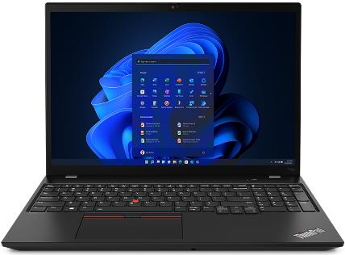
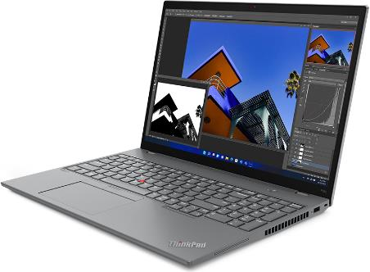
THINKPAD TOPSELLER
Mobile Workstations - AMD
[ 3 OF 3 ]
P16s Gen 1 - AMD | $2619 Rebate $250 | $2789 Rebate $250
 | 21CK001MUS | 21CK001PUS
 | Ryzen 7 PRO 6850U | Ryzen 7 PRO 6850U
 | 16GB DIMM | 32GB DIMM
 | 512GB SSD NVMe | 512GB SSD NVMe
 | 16” WQXGA IPS Anti-glare | 16” WQXGA IPS Anti-glare
 | Integrated AMD Radeon 680M | Integrated AMD Radeon 680M
 | IR Camera w/Shutter, FPR, 2x2 AX WLAN, BT, Backlit Keyboard | IR Camera w/Shutter, FPR, 2x2 AX WLAN, BT, Backlit Keyboard
 | Win11 Pro DG Win10 | Win11 Pro DG Win10
 | 3 Year Premier | 3 Year Premier
P14s Gen 3 - AMD | $2509 Rebate $100 | $2789 Rebate $100
 | 21J5001LUS | 21J5001VUS
 | 21J5001LCA | 21J5001VCA
 | Ryzen 7 PRO 6850U | Ryzen 7 PRO 6850U
 | 16GB DIMM | 32GB DIMM
 | 512GB SSD NVMe | 512GB SSD NVMe
 | 14” WQXGA IPS Anti-glare | 14” WQXGA IPS Anti-glare Touch
 | Integrated AMD Radeon 680M | Integrated AMD Radeon 680M
 | IR Camera w/Shutter, FPR, 2x2 AX WLAN, BT, Backlit Keyboard | IR Camera w/Shutter, FPR, 2x2 AX WLAN, BT, Backlit Keyboard
 | Win11 Pro DG Win10 | Win11 Pro DG Win10
 | 3 Year Premier | 3 Year Premier
P15v Gen1
P15v Gen 1 - AMD | $2569 Rebate $100 | $3449 Rebate $100
 | 21EM001JUS | 21EM001NUS
 | 21EM001JCA | 21EM001NCA
 | Ryzen 5 PRO 6650H | Ryzen 7 PRO 6850H
 | 16GB DIMM | 2x 16GB DIMM
 | 512GB SSD NVMe | 1TB SSD NVMe
 | 15.6” FHD IPS Anti-glare | 15.6” FHD IPS Anti-glare
 | NVIDIA T600 | NVIDIA RTX A2000
 | IR Camera w/Shutter, FPR, 2x2 AX WLAN, BT, Backlit Keyboard | IR Camera w/Shutter, FPR, 2x2 AX WLAN, BT, Backlit Keyboard
 | Win11 Pro DG Win10 | Win11 Pro DG Win10
 | 3 Year Premier | 3 Year Premier
P14s Gen3
P16s Gen1

Slide 21
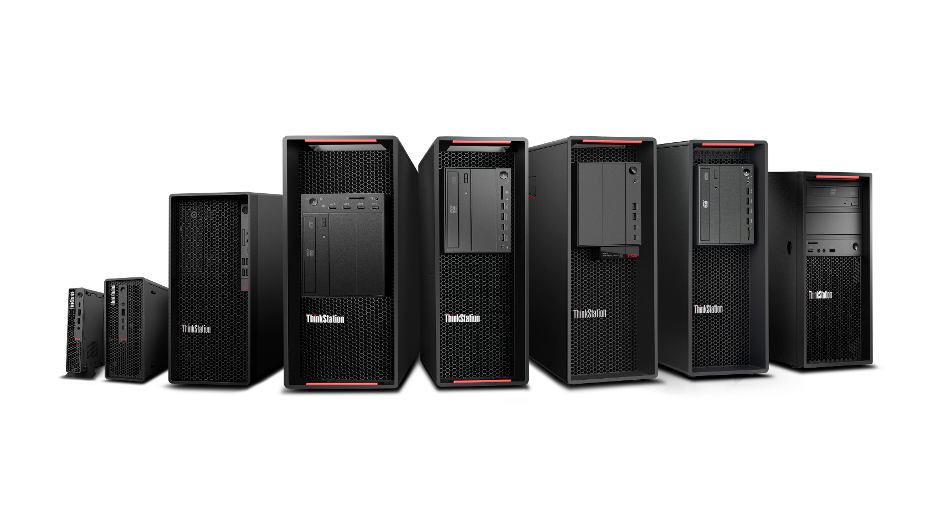
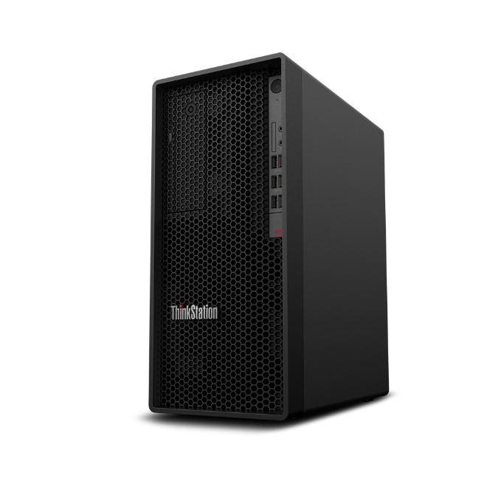
THINKSTATION TOPSELLER
Desktop Workstations
[ 1 OF 3 ]
P360 Ultra
REDEFIGNING THE POWER OF SMALL
P920
MOST
ADVANCED
DUAL-PROCESSOR WORKSTATION
P720
PROFESSIONAL POWER WITH ULTIMATE
VERSATILITY
P520
THE MOST
POWERFUL
SINGLE CPU WORKSTATION
P360 Tower
POWER OF A WORKSTATION,
PRICE OF A
DESKTOP
P360 Tiny
WORLD’S SMALLEST WORKSTATION
P620
LIMITLESS
POSSIBILITIES
P520c
HIGH
PERFORMANCE WITHOUT THE HIGH PRICE
P348 (Intel) / P358 (AMD) Tower
SUB-ENTRY WORKSTATION

Slide 22
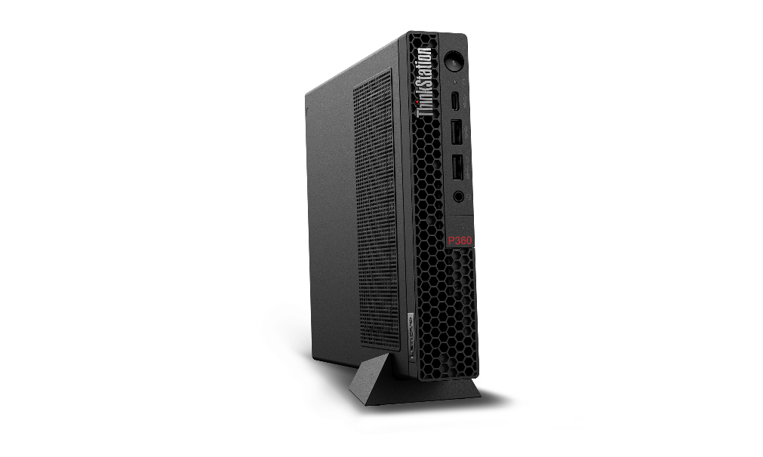
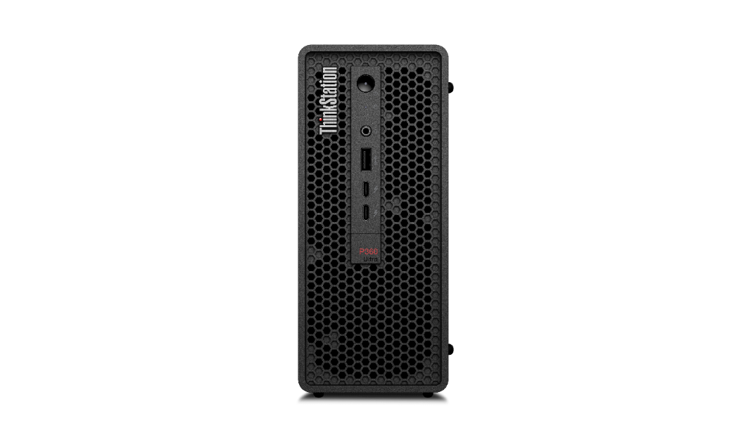
THINKSTATION TOPSELLER
Desktop Workstations
[ 2 OF 3 ]
P360 Tiny | $1559 | $2099 | $2849 | $3199
 | 30FA001CUS | 30FA001EUS | 30FA001BUS | 30FA005SUS
 | 30FA001CCA | 30FA001ECA | 30FA001BCA | 30FA005SCA
 | Core i7-12500T | Core i7-12700T | Core i7-12700T | Core i9-12900T
 | 16GB Memory | 16GB Memory | 32GB Memory | 32GB Memory
 | 512GB SSD M.2 PCIe | 512GB SSD M.2 PCIe | 1TB SSD M.2 PCIe | 1TB SSD M.2 PCIe
 | Integrated Graphics | NVIDIA T400 4GB | NVIDIA T1000 | NVIDIA T1000
 | Win11 Pro | Win11 Pro | Win11 Pro | Win11 Pro DG Win10
 | 3 Year Onsite Premier | 3 Year Onsite Premier | 3 Year Onsite Premier | 3 Year Onsite Premier
P360 Ultra | $2369 | $2489 | $3599 | $3999
 | 30G1001AUS | 30G1000LUS | 30G1000KUS | 30G1001DUS
 | 30G1001ACA | 30G1000LCA | 30G1000KCA | 30G1001DCA
 | Core i7-12700 | Core i5-12600 | Core i7-12700 | Core i9-12900
 | 16GB Memory | 16GB Memory | 32GB Memory | 32GB Memory
 | 512GB SSD M.2 PCIe | 512GB SSD M.2 PCIe | 1TB SSD M.2 PCIe | 1TB SSD M.2 PCIe
 | NVIDIA T400 | NVIDIA T1000 | NVIDIA RTX A2000 | NVIDIA RTX A2000
 | Win11 Pro | Win11 Pro | Win11 Pro | Win11 Pro
 | 3 Year Onsite Premier | 3 Year Onsite Premier | 3 Year Onsite Premier | 3 Year Onsite Premier
P360 Tiny
P360 Tower | $2849 | $4129 Rebate $100
 | 30FM0018US | 30FM0015US
 | 30FM0018CA | 30FM0015CA
 | Core i9-12900K | Core i7-12700
 | 32GB Memory | 32GB Memory
 | 1TB SSD M.2 PCIe | 1TB SSD M.2 PCIe
 | Integrated Graphics | NVIDIA RTX A4000
 | Win11 Pro | Win11 Pro
 | 3 Year Onsite Premier | 3 Year Onsite Premier
P348 Tower – Intel | $2289 | $2559 | $2919
 | 30EQ025CUS | 30EQ025DUS | 30EQ024HUS
 | 30EQ025CCA | 30EQ025DCA | 30EQ024PCA
 | Core i5 – 11600 | Core i7-11700 | Core i9-11900
 | 16GB Memory | 16GB Memory | 32GB Memory
 | 512GB SSD M.2 PCIe | 512GB SSD M.2 PCIe | 1TB SSD M.2 PCIe
 | NVIDIA RTX 3060 | NVIDIA RTX 3060 | NVIDIA T1000
 | Win11 Pro | Win11 Pro | Win11 Pro
 | 3 Year Onsite Premier | 3 Year Onsite Premier | 3 Year Onsite Premier
P358 Tower – AMD | $2499 | $3319
 | 30GL0052US | 30GL0051US
 | 30GL0052CA | 30GL0051CA
 | Ryzen 7 PRO 5845 | Ryzen 9 PRO 5945
 | 16GB Memory | 32GB Memory
 | 512GB SSD M.2 PCIe | 1TB SSD M.2 PCIe
 | NVIDIA RTX 3060 | NVIDIA RTX 3060
 | Win11 Pro | Win11 Pro
 | 3 Year Onsite Premier | 3 Year Onsite Premier
P360 Ultra

Slide 23



THINKSTATION TOPSELLER
Desktop Workstations
[ 3 OF 3 ]
P520c | $5859
 | 30BX00FVUS
 | 30BX00JRCA
 | Xeon W-2225
 | 32GB Memory
 | 1TB SSD M.2 PCIe
 | NVIDIA RTX A4500
 | Win11 Pro
 | 3 Year Onsite Premier
P520 | $2429 | $3259 Rebate $100
 | 30BE00NMUS | 30BE00NLUS
 | 30BE00RDCA | 30BE00R6CA
 | Xeon W-2225 | Intel Xeon W-2245
 | 16GB Memory | 32GB Memory
 | 512GB SSD M.2 PCIe | 1TB SSD M.2 PCIe
 | Open GPU | Open GPU
 | Win11 Pro | Win11 Pro
 | 3 Year Onsite Premier | 3 Year Onsite Premier
P620 | $4159 Rebate $300 | $6809 Rebate $300
 | 30E000M9US | 30E000MRUS
 | Ryzen Threadripper PRO 5945WX | AMD Ryzen Threadripper PRO 5955WX
 | 2x 16GB Memory | 4x 16GB Memory
 | 1TB SSD M.2 PCIe | 2TB SSD M.2 PCIe
 | NVIDIA T400 | NVIDIA RTX A2000
 | Win11 Pro | Win11 Pro
 | 3 Year Onsite Premier | 3 Year Onsite Premier
P520
P720 | $3519 | $4149
 | 30BA00K0US | 30BA00K4US
 | 30BA00KUCA | 30BA00KRCA
 | 1x Xeon Silver 4214R | 2x Xeon Silver 4210R
 | 16GB Memory | 2x 16GB Memory
 | 512GB SSD M.2 PCIe | 1TB SSD M.2 PCIe
 | Open GPU | Open GPU
 | Win11 Pro | Win11 Pro
 | 3 Year Onsite Premier | 3 Year Onsite Premier
P520c
P720
(monitor not included)

Slide 24
DTWS GPU Comparison Table
THINKSTATION TOPSELLER
Desktop Workstations
[ 1 OF 1 ]
GPU Model | Architecture | Frame Buffer Size or VRAM | Memory Type | Memory Interface | CUDA Cores / Stream Processors | RT Cores | Tensor Cores | VR Ready | Offered on
NVIDIA T400(miniDP x3) - 2GB GDDR6 | Turing | 2GB | GDDR6 | 64-bit | 384 | N/A | N/A |  | P360 TWR,P350TWR/SFF, P340TWR/SFF,P348, P520, P520c, P720, P920
NVIDIA T400(miniDP x3) - 4GB GDDR6 | Turing | 4GB | GDDR6 | 64-bit | 384 | N/A | N/A |  | P360 TWR, P350TWR/SFF, P340TWR/SFF, P348, P358, P360 Tiny, P360 Ultra, P520, P520c, P620, P720, P920
NVIDIA T600(miniDP x4) - 4GB GDDR6 | Turing | 4GB | GDDR6 | 128-bit | 640 | N/A | N/A |  | P360 TWR,P350TWR/SFF, P340TWR/SFF,P348, P350 Tiny, P360 Tiny, P520, P520c, P620, P720, P920
NVIDIA Quadro T1000(miniDP x4) - 4GB GDDR6 | Turing | 4GB | GDDR6 | 128-bit | 896 | N/A | N/A |  | P360 TWR, P350 TWR/SFF, P340TWR/SFF, P348, P350 Tiny, P360 Tiny, P520, P520c, P620, P720, P920
NVIDIA Quadro T1000(miniDP x4) - 8GB GDDR6 | Turing | 8GB | GDDR6 | 128-bit | 896 | N/A | N/A |  | P360 TWR, P350 TWR/SFF, P340 TWR/SFF, P348, P358, P340 Tiny, P350 Tiny, P360 Tiny, P360 Ultra, P520, P520c, P620, P720, P920
NVIDIA Quadro A2000(DP x4) - 6GB GDDR6 | Ampere | 6GB | GDDR6 | 192-bit | 3,328 | 26 | 104 | X | P360 TWR, P350 TWR/SFF, P340TWR, P520, P520c, P620, P720, P920
NVIDIA Quadro A2000(DP x4) - 12GB GDDR6 | Ampere | 12GB | GDDR6 | 192-bit | 3,328 | 26 | 104 | X | P360 TWR, P350TWR/SFF, P340 TWR, P358, P360 Ultra, P520, P520c, P620, P720, P920
NVIDIA Quadro A4000(DP x4) - 16GB GDDR6 | Ampere | 16GB | GDDR6 | 256-bit | 6,144 | 48 | 192 | X | P360 TWR, P350 TWR, P520, P520c, P620, P720, P920
NVIDIA Quadro RTX A4500(DP x4) - 24GB GDDR6 | Ampere | 24GB | GDDR6 | 320-bit | 7,168 | 56 | 224 | X | P360 TWR, P520, P520c, P620, P720, P920
Nvidia RTX A5000 mobile,16GB, 4miniDP,GDDR6 | Ampere | 16GB | GDDR6 | 256-bit | 6,144 | 48 | 192 | X | P360 Ultra
NVIDIA Quadro RTX A5000(DP x4) - 24GB GDDR6 | Ampere | 24GB | GDDR6 | 384-bit | 10,240 | 64 | 256 | X | P360 TWR, P350 TWR, P520, P520c, P620, P720, P920
NVIDIA Quadro RTX A5500(DP x4) - 24GB GDDR6 | Ampere | 24GB | GDDR6 | 384-bit | 10,240 | 80 | 320 | X | P520, P520c, P620, P720, P920
NVIDIA Quadro RTX A6000(DP x4) - 24GB GDDR6 | Ampere | 48GB | GDDR6 | 384-bit | 10,752 | 84 | 336 | X | P520, P520c, P620, P720, P920
NVIDIA GeForce GTX1660 Super(1xDP,1xHDMI,1xDVI-D) - 6GB GDDR6 | Turing | 4GB | GDDR6 | 128-bit | 1,408 | N/A | N/A | X | P340 TWR, P348
NVIDIA Geforce RTX 3060(DP x3, HDMI x1) - 12GB GDDR6X | Ampere | 8GB | GDDR6 | 192-bit | 3,584 | 38 | 152 | X | P360 TWR, P350 TWR, P348, P358
NVIDIA Geforce RTX 3060Ti(DP x3, HDMI x1) - 8GB GDDR6X | Ampere | 8GB | GDDR6X | 256-bit | 4,864 | 38 | 152 | X | P520, P520c, P620,
NVIDIA Geforce RTX 3070Ti(DP x3, HDMI x1) - 8GB GDDR6X | Ampere | 8GB | GDDR6X | 256-bit | 6,144 | 48 | 192 | X | P360 TWR, P358, P520, P520c, P620, P720
NVIDIA GeForce RTX 3080(DPx3, HDMIx1) - 10GB DDR6X | Ampere | 10GB | GDDR6X | 320-bit | 8,704 | 68 | 272 | X | P360 TWR, P358, P520, P620, P720
NVIDIA GeForce RTX 3080Ti (DPx3, HDMIx1) - 10GB DDR6X | Ampere | 12GB | GDDR6X | 320-bit | 10,240 | 80 | 320 | X | P520, P620
AMD Radeon Pro WX3200 (MiniDP x 4) 4GB DDR5 HP | Polaris | 4GB | GDDR5 | 128-bit | 640 | 12 | N/A |  | P350 TWR/SFF,P340TWR/SFF,P348, P360 Ultra
AMD Radeon Pro W6400 (DP x 2) 4GB DDR6 | RDNA 2 | 4GB | GDDR6 | 64-bit | 768 | 12 | N/A |  | P620, P358 Ref2.0, P360Tower Ref2.0
AMD Radeon Pro W6600 (DP x 4) 8GB DDR6 | RDNA 2 | 8GB | GDDR6 | 128-bit | 1792 | 28 | N/A |  | P620
AMD Radeon Pro W6800 (mDP x 6) 32GB DDR6 | RDNA 2 | 32GB | GDDR6 | 256-bit | 3840 | 60 | N/A |  | P620
Intel® UHD Graphics 770 | 770 | N/A | UDIMM ECC/No-ECC, DPC DDR4 @ 1.2V | 256-bit | N/A | N/A | N/A |  | P360 TWR, P360 Ultra, P360 Tiny

Slide 25




Attach and Upgrade Options for Workstations
THINKSTATION TOPSELLER
Desktop Workstations
[ 1 OF 1 ]
Prices shown do not include rebate (if available).
Attach Performance Displays – Lenovo’s Best!
24” | $459 P24q-20 61F5GAR1US 23.8-inch QHD No USB-C Daisy chain capable | $559 P24h-2L 62B2GAR1US 23.8-inch QHD 2560x1440 USB-C (up to 70w) Daisy chain capable
27” | $576 P27q-20 61EAGAR6US 27-inch QHD 4-sided near-edgeless 2560x1440 Daisy chain capable | $724 P27h-20 61E9GAR6US 27-inch QHD 4-sided near-edgeless USB-C (90W) Integrated RJ45 Daisy chain capable
32” | $1,484 P32p-20 62A2GAR2US 32-inch 4K UHD USB-C (up 90W) Integrated RJ45 Integrated phone holder stand
P340 SFF | P340 TWR | P350 SFF | P350 TWR | P348 TWR | P358 TWR
$201.99 - 4X60N86656 NVIDIA Quadro P400 2GB $359.99 - 4X60R60469 NVIDIA Quadro P620 2GB $604.99 - 4X60N86660 NVIDIA Quadro P1000 4GB $229.99 - 4X61J52234 NVIDIA T400 4GB $599.99 - 4X61J52233 NVIDIA T1000 8GB | $499.99 - 4X61E26088 NVIDIA T1000 4GB $229.99 - 4X61J52234 NVIDIA T400 4GB $599.99 - 4X61J52233 NVIDIA T1000 8GB $1,049.99 - 4X61J52232 NVIDIA RTX A2000 12GB $1,749.99 - 4X61E26089 NVIDIA A4000 16GB | $297.99 - 4X61H02424 NVIDIA T600 4GB $229.99 - 4X61J52234 NVIDIA T400 4GB $599.99 - 4X61J52233 NVIDIA T1000 8GB $1,049.99 - 4X61J52232 NVIDIA RTX A2000 12GB | $179.99 - 4X61F99432 NVIDIA T400 2GB $299.99 - 4X61E26090 NVIDIA T1000 4GB $699.99 - 4X61F99433 NVIDIA RTX A2000 6GB $229.99 - 4X61J52234 NVIDIA T400 4GB $599.99 - 4X61J52233 NVIDIA T1000 8GB $1,049.99 - 4X61J52232 NVIDIA RTX A2000 12GB $1,749.99 - 4X61E26089 NVIDIA A4000 16GB $3,499.99 - 4X61D97085 NVIDIA A5000 24GB | $179.99 - 4X61F99432 NVIDIA T400 2GB $299.99 - 4X61E26090 NVIDIA T600 4GB $499.99 - 4X61E26088 NVIDIA T1000 4GB
P360 Ultra | P360 TWR | P520c | P520 | P620 | P720/P920
$229.99 - 4X61J52234 NVIDIA T400 4GB $599.99 - 4X61J52233 NVIDIA T1000 8GB $1,049.99 - 4X61J52232 NVIDIA RTX A2000 12GB | $179.99 - 4X61F99432 NVIDIA T400 2GB $299.99 - 4X61E26090 NVIDIA T600 4GB $499.99 - 4X61E26088 NVIDIA T1000 4GB $699.99 - 4X61F99433 NVIDIA RTX A2000 6GB $229.99 - 4X61J52234 NVIDIA T400 4GB $599.99 - 4X61J52233 NVIDIA T1000 8GB $1,049.99 - 4X61J52232 NVIDIA RTX A2000 12GB $1,749.99 - 4X61E26089 NVIDIA A4000 16GB $2,599.99 - 4X61J77360 NVIDIA A4500 20GB $3,499.99 - 4X61D97085 NVIDIA A5000 24GB | $604.99 - 4X60N86661 NVIDIA Quadro P1000 4GB $169.99 - 4X61F99432 NVIDIA T400 2GB $299.99 - 4X61E26090 NVIDIA T600 4GB $499.99 - 4X61E26088 NVIDIA T1000 4GB $229.99 - 4X61J52234 NVIDIA T400 4GB $1,049.99 - 4X61J52232 NVIDIA RTX A2000 12GB $1,749.99 - 4X61E26089 NVIDIA A4000 16GB $2,599.99 - 4X61J77360 NVIDIA A4500 20GB $3,499.99 - 4X61D97085 NVIDIA A5000 24GB | $179.99 - 4X61F99432 NVIDIA T400 2GB $299.99 - 4X61E26090 NVIDIA T600 4GB $499.99 - 4X61E26088 NVIDIA T1000 4GB $699.99 - 4X61F99433 NVIDIA RTX A2000 6GB $229.99 - 4X61J52234 NVIDIA T400 4GB $599.99 - 4X61J52233 NVIDIA T1000 8GB $1,049.99 - 4X61J52232 NVIDIA RTX A2000 12GB $1,749.99 - 4X61E26089 NVIDIA A4000 16GB $2,599.99 - 4X61J77360 NVIDIA A4500 20GB $3,499.99 - 4X61D97085 NVIDIA A5000 24GB $7,919.99 - 4X61D17227 NVIDIA A6000 48GB | $359.99 - 4X60R60468 NVIDIA Quadro P620 2GB $604.99 - 4X60N86661 NVIDIA Quadro P1000 4GB $299.99 - 4X61E26090 NVIDIA T600 4GB $499.99 - 4X61E26088 NVIDIA T1000 4GB $1,749.99 - 4X61E26089 NVIDIA A4000 16GB $3,499.99 - 4X61D97085 NVIDIA A5000 24GB $7,919.99 - 4X61D17227 NVIDIA A6000 48GB | $186.99 - 4X60N86657 NVIDIA Quadro P400 2GB $359.99 - 4X60R60468 NVIDIA Quadro P1000 4GB $179.99 - 4X61F99432 NVIDIA T400 2GB $299.99 - 4X61E26090 NVIDIA T600 4GB $499.99 - 4X61E26088 NVIDIA T1000 4GB $699.99 - 4X61F99433 NVIDIA RTX A2000 6GB $229.99 - 4X61J52234 NVIDIA T400 4GB $599.99 - 4X61J52233 NVIDIA T1000 8GB $1,049.99 - 4X61J52232 NVIDIA RTX A2000 12GB $1,749.99 - 4X61E26089 NVIDIA A4000 16GB $2,599.99 - 4X61J77360 NVIDIA A4500 20GB $3,499.99 - 4X61D97085 NVIDIA A5000 24GB $7,919.99 - 4X61D17227 NVIDIA A6000 48GB

Slide 26

LENOVO SERVICES
Looking for the latest Services and Software information?
Check out SmartFind for compatible Services & Software for EDU, ThinkPad, ThinkCentre, ThinkStation models
https://smartfind.lenovo.com/#/

